Slide 1
CMSC424: Database Design Module: NoSQL; Big Data Systems
Overview
Instructor: Amol Deshpande
amol@umd.edu

Slide 2
NoSQL and Big Data Systems: Motivation
Book Chapters
10.1, 10.2 (7TH EDITION)
Key topics:
Big data motivating scenarios
Why systems so far (relational databases, data warehouses, parallel databases) don’t work

Slide 3
RDBMS: Application Scenarios
Online Transaction Processing (OLTP)
E-commerce, Airline Reservations, Class registrations, etc.
Simple queries (get all orders for a customer)
Many updates (inserts, updates, deletes)
Need ACID properties (consistency, etc.)
Online Analytical Processing (OLAP)
Decision-support, data mining, ML (today), etc.
Huge volumes of data, but not updated
Complex, but read-only queries (many joins, group-by’s)

Slide 4
RDBMS Evolution
Original database systems aimed to support both use cases
Slowly, specialized systems were built, starting late 80’s-early 90’s, especially for decision support (Data Warehouses)
Today, different RDBMSs systems for different use cases, e.g.,:
VoltDB for OLTP – fully in-memory, very fast transactions, but no complex queries
(OLAP) Teradata, Aster Data, Snowflake, AWS Redshift – handle PBs of data, but batch updates only – many indexes and summary structures (cubes) for queries – typically “parallel” (i.e., use many machines)
Fundamental and wide differences in the technology
But both still support SQL as the primary interface (with visualizations, exploration, and other tools on top)

Slide 5
NoSQL + Big Data Systems: Motivation
Very large volumes of data being collected
Driven by growth of web, social media, and more recently internet-of-things
Web logs were an early source of data
Analytics on web logs has great value for advertisements, web site structuring, what posts to show to a user, etc
Big Data: differentiated from data handled by earlier generation databases
Volume: much larger amounts of data stored
Velocity: much higher rates of insertions
Variety: many types of data, beyond relational data

Slide 6
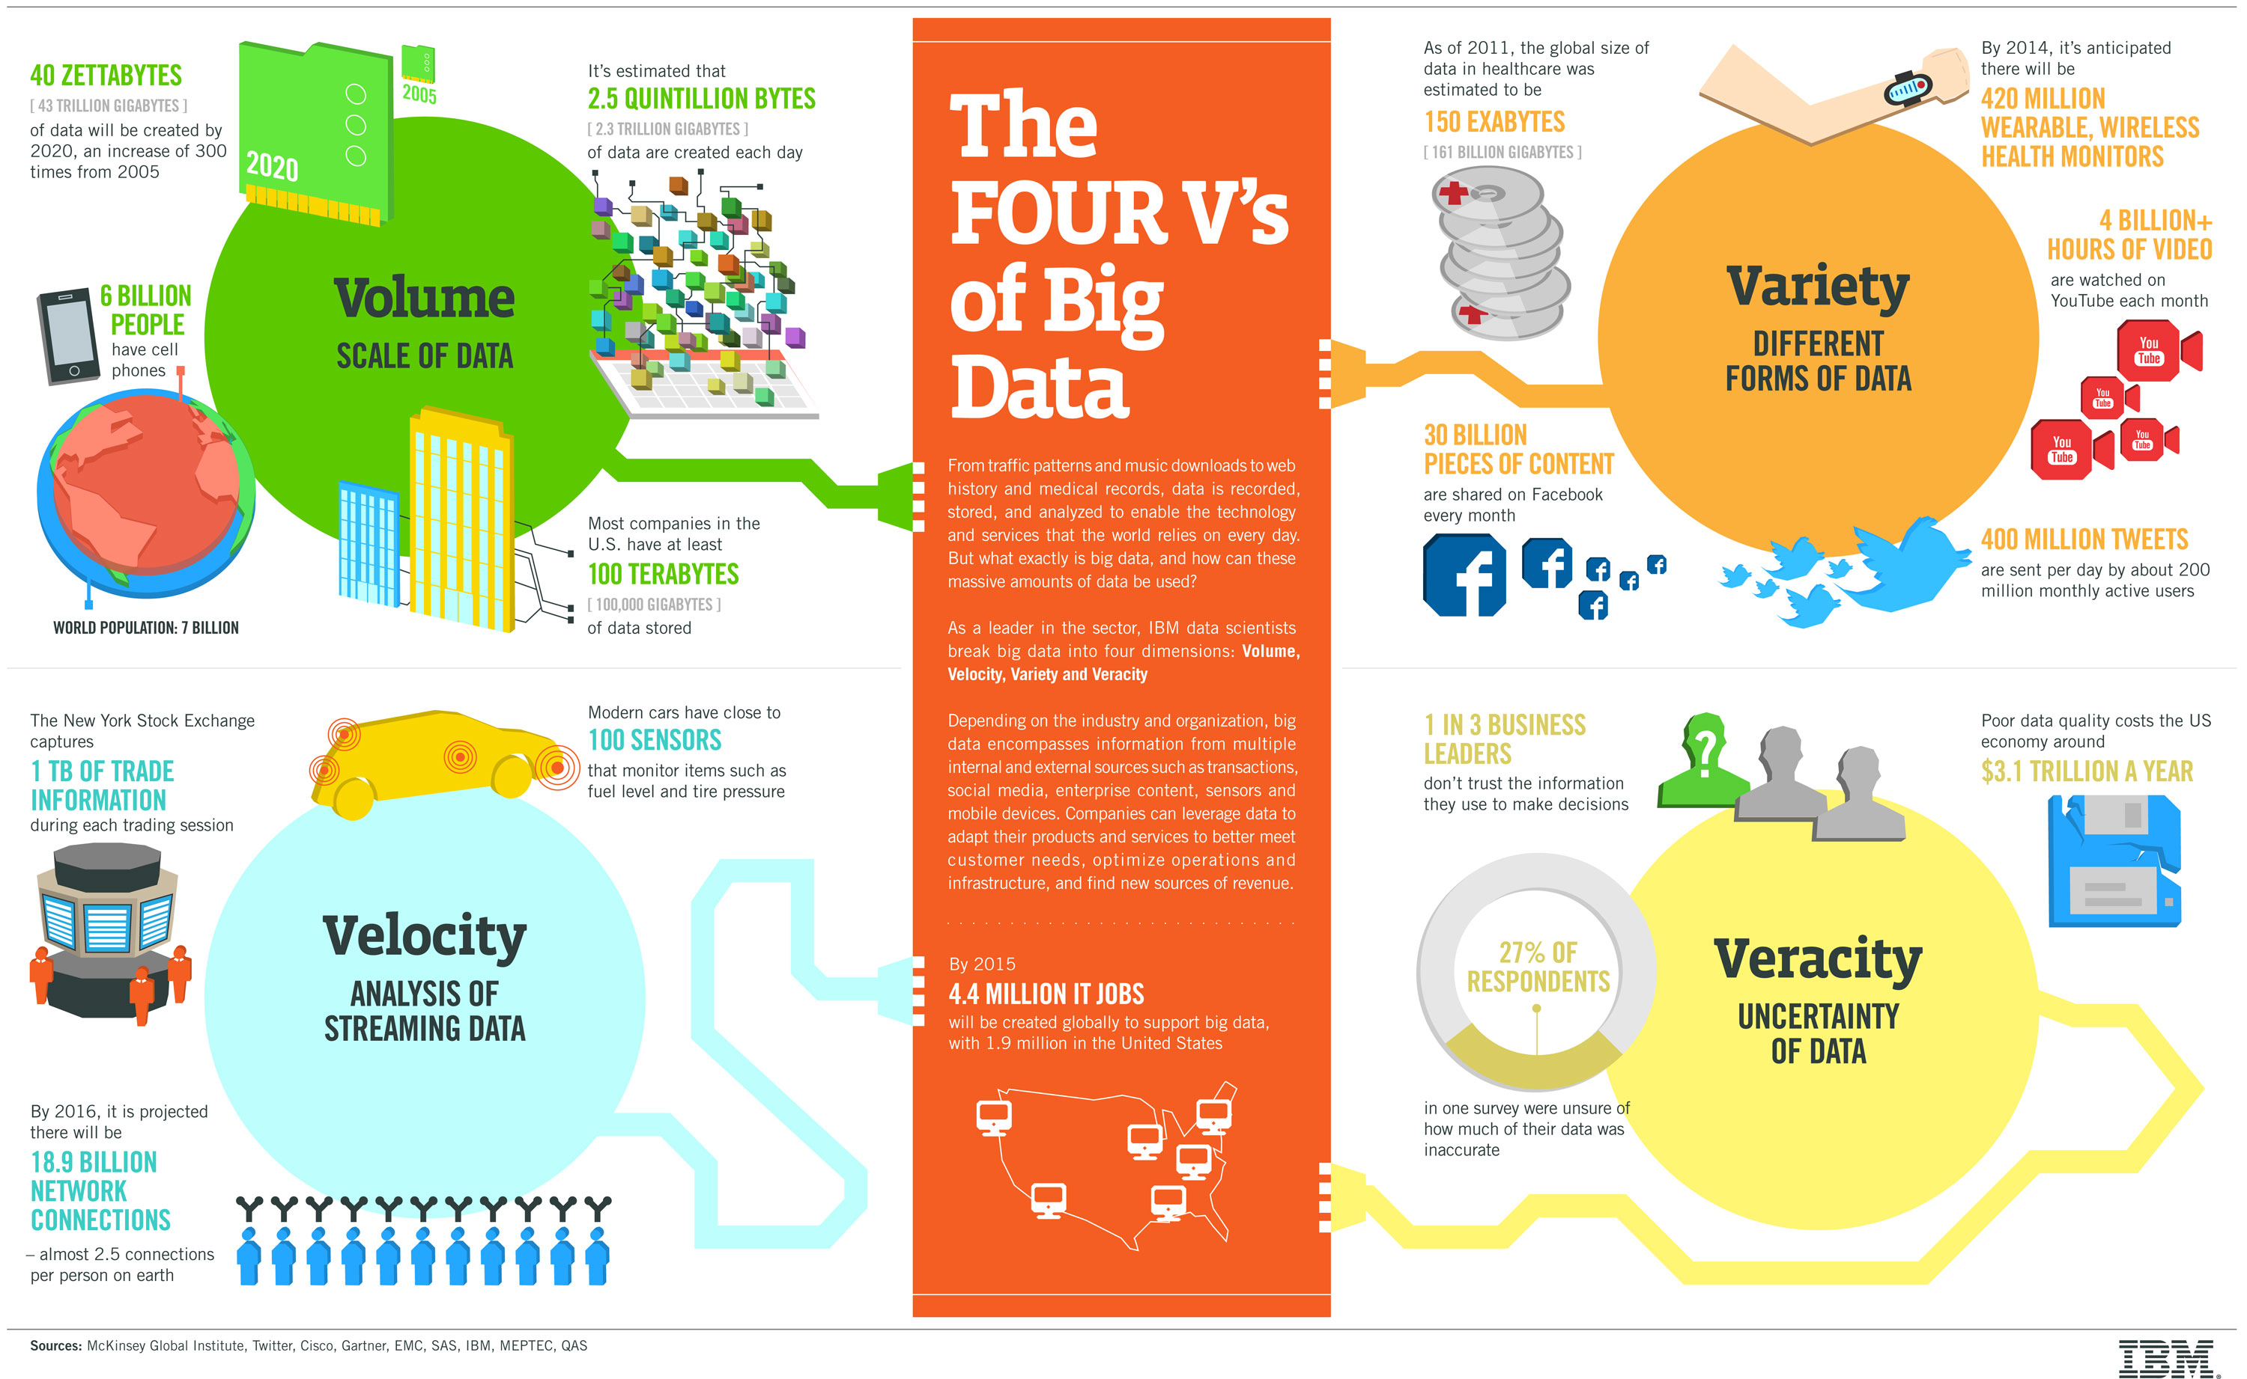

Slide 7
Some motivating scenarios
Deciding what to show a user in a social network, or news aggregator
Advertising on the Web or Mobile
Analyzing user behavior on web sites to optimize or increase engagement
Analyzing large numbers of images and building search indexes on them
Text analytics for topic modelling, summarization, …
Internet of things…
And many many others…

Slide 8
Two Primary Use Cases
OLTP-like
Simple queries, but lots of updates
Need to support distributed users
Need to support non-relational data (e.g., graphs, JSONs)
Need to scale fast (10 users to 10s of Millions of Users)
Need to work well in 3-tier Web Apps
Need to support fast schema changes
OLAP-like
Complex analysis on large volumes of data
Often no “real-time” component, and no updates
Mostly non-relational data (images, webpages, text, etc)
Tasks often procedural in nature (analyse webpages for searching, data cleaning, ML)
NoSQL Storage Systems: HDFS, Cassandra, MongoDB, Neo4j, AWS DynamoDB, and many many others
Big data frameworks:
Hadoop MapReduce, Flink, Spark, and many others

Slide 9
Why (Parallel) Databases Don’t Work
The data is often not relational in nature
E.g., images, text, graphs
The analysis/queries are not relational in nature
E.g., Image Analysis, Text Analytics, Natural Language Processing, Web Analytics, Social Network Analysis, Machine Learning, etc.
Databases don’t really have constructs to support this
User-defined functions can help to some extent
Need to interleave relational-like operations with non-relational (e.g., data cleaning, etc.)
Domain users are more used to procedural languages
The operations are often one-time
Only need to analyse images once in a while to create a “deep learning” model
Databases are really better suited for repeated analysis of the data
Much of the analysis not time-sensitive
Parallel databases too expensive given the data volumes
Were designed for large enterprises, with typically big budgets

Slide 10
Examples of Systems
Too much variety in the systems out there today
different types of data models supported
Files/Objects (HDFS, AWS S3), Document (MongoDB), Graph (Neo4j), Wide-table (Cassandra, DynamoDB), Multi-Model (Azure CosmosDB)
different types of query languages or frameworks or workloads
SQL (Snowflake, Redshift, …), MongoQL, Cassandra QL, DataFrames (Spark), MapReduce (Hadoop), TensorFlow for ML, …
different environmental assumptions
Distributed vs parallel, disks or in-memory only, single-machine or not, streaming or static, etc.
different performance focus and/or guarantees
e.g., consistency guarantees in a distributed setting differ quite a bit
Many of these systems work with each
e.g., Spark can read data from most of the storage systems
Interoperability increasing a requirement

Slide 11
Questions
Optimizing a news aggregator platform -- what's most crucial for analyzing user behavior to increase engagement?
Storing user data in a single, centralized database
Performing complex OLAP queries on relational data
Utilizing text analytics for topic modeling and summarization
Restricting data analysis to real-time updates only
What is an essential database feature for supporting a rapidly scaling social networking site, growing from 10 to tens of millions of users?
Strict ACID transaction compliance
Ability to perform complex joins on relational data
Support for fast schema changes and distributed users
Sole reliance on OLTP for all database operations

Slide 12
Questions
For advertising on mobile platforms, why is analyzing large volumes of non-relational data (e.g., user clickstreams, app usage patterns) using OLAP-like systems preferred?
Real-time data updates are crucial
Simple queries with few updates are sufficient
Complex analysis on large datasets offers deeper insights
Only relational data models are supported for mobile advertising
In the context of the Internet of Things (IoT), which database feature is most critical for handling data from distributed devices?
Support for relational data models
Capability to handle non-relational data such as JSONs and graphs
Focus on OLAP-like systems for complex analysis
No need for supporting distributed users

Slide 13
Questions
Why might parallel databases be considered ineffective for analyzing social network data?
Social network analysis relies solely on relational data models
The analysis often requires interleaving relational-like operations with non-relational tasks, such as data cleaning
User-defined functions are not helpful in social network analysis
Parallel databases are specifically designed for social network analysis
Considering the need for interoperability among different systems, which of the following is an increasingly important requirement?
Reducing the variety of data models supported
Limiting systems to either SQL or NoSQL query languages
Ensuring that systems can work with each other, like Spark reading data from various storage systems
Focusing solely on parallel databases for all use cases

Slide 14
Questions
Why are databases that support fast schema changes and distributed users critical for 3-tier web applications?
They ensure data is stored in a centralized location for easy access
They provide consistency guarantees in a distributed setting
They facilitate the rapid development and scaling of web applications by adapting to changing data models and user bases
They limit the application to relational data models for simplicity
Why are domain users, especially those working with big data and non-relational databases, more inclined towards systems that allow procedural languages and user-defined functions?
Procedural languages are less powerful and versatile than SQL
These features offer a way to perform customized, complex analyses that go beyond traditional relational operations, including data cleaning and machine learning
Relational databases provide all the necessary constructs for big data analysis
Parallel databases are too cost-effective and efficient to consider alternatives

Slide 15
What We Will Cover
Apache Spark
Current leader in big data (OLAP-style) frameworks
Supports many query/analysis models, including a light version of SQL
MongoDB
Perhaps the most popular NoSQL system, uses a ”document” (JSON) data model
Focus primarily on OLTP
Doesn’t really support joins (some limited ability today) – have to do that in the app
How to “Parallelize” Operations
Useful to understand how Spark and other systems actually work
Often times you have to build these in the application layer
The original MapReduce framework
Led to development of much work on large-scale data analysis (OLAP-style)
Basically a way to execute a group-by at scale on non-relational data
Hadoop Distributed File System (briefly)
A key infrastructure piece, with no real alternative
Basic file system interface, with replication and redundancy built in for failures
Quick overview of other NoSQL data models

Slide 16
Plan
Operations on Datasets
Parallel Architectures
Parallelizing Data-centric Operations
Apache Spark
Map-Reduce
MongoDB
Other NoSQL Systems

Slide 17
CMSC424: Database Design Module: NoSQL; Big Data Systems
Operations on Datasets
Instructor: Amol Deshpande
amol@umd.edu

Slide 18
Operations on Datasets
So far we have focused on “relations”/”tables”
Basically “multisets” of “tuples”
Let’s generalize that concept and discuss a few more operations
Each operation takes in one or more datasets as input
… and outputs one dataset
But what is a “dataset”?

Slide 19
Inputs and Outputs
Sets or “multi-sets” or “collections” of ..
Objects → key-value pairs → tuples
o1
o2
o3
o4
k1 | o1
k1 | o2
k2 | o3
k3 | o4
Set of objects (e.g., images, JSON documents)
Set of key-value pairs (e.g., pairs of (userid, profile))
o1
o1
o1
o4
^{A}
^{B}
^{C}
^{D}
⍺
⍺
^{β}
^{β}
⍺
^{β}
^{β}
^{β}
¹
⁵
¹²
²³
⁷
⁷
³
¹⁰
Multi-set of objects
Set of tuples
aka Relation/Table

Slide 20
Operations on Datasets
So far we have focused on “relations”/”tables”
Basically “multisets” of “tuples”
Let’s generalize that concept and discuss a few more operations
Each operation takes in one or more datasets as input
… and outputs one dataset
An operation that works on a collection of “objects” also works on a collection of ”key-value pairs” or “tuples”

Slide 21
Select/Find/Match/Filter
Input: Object Collection, Output: Object Collection
So also works on Relations
Select only those objects that match the condition
Need a predicate or a “function” that returns a boolean
SQL: “where”
^{Relation r}
^{A}
^{B}
^{C}
^{D}
^{σ}_{A=B ∧ D > 5} ^{(r)}
^{A}
^{B}
^{C}
^{D}
⍺
⍺
^{β}
^{β}
⍺
^{β}
^{β}
^{β}
¹
⁵
¹²
²³
⁷
⁷
³
¹⁰
⍺
^{β}
⍺
^{β}
¹
²³
⁷
¹⁰

Slide 22
Select/Find/Match/Filter
Input: Object Collection, Output: Object Collection
So also works on Relations
Select only those objects that match the condition
Need a predicate or a “function” that returns a Boolean
More generally:
D.filter(f): where “f” is a Boolean function
^{Input}
o1
o2
o3
o4
f(o1) = T
f(o2) = F
f(o3) = F
f(o4) = T
o1
o4

Slide 23
Project/Map
Input: Object Collection, Output: Object Collection
For each object, output a transformed object
Need a way to specify the transformation
SQL can handle this through UDFs and “select” clause
select f(r.a, r.b) from R;
^{Input t}
^{t.map(f)}
o1
o2
o3
o4
f(o1)
f(o2)
f(o3)
f(o4)

Slide 24
Map Example
Input: a collection of log records
^{Output: IP addresses}
199.72.81.55
unicomp6.unicomp.net
….
…
199.72.81.55 - - [01/Jul/1995:00:00:01 -0400] "GET /history/apollo/ HTTP/1.0" 200 6245
unicomp6.unicomp.net - - [01/Jul/1995:00:00:06 -0400] "GET /shuttle/countdown/ HTTP/1.0" 200 3985
…
…
map: use regex to extract IP address

Slide 25
Project/Map
Input: Object Collection, Output: Object Collection
For each object, output a transformed object
Need a way to specify the transformation
SQL Project is a simplification of this
^{Relation r}
^{A}
^{B}
^{C}
^{D}
^{π}_{A,D} ^{(r)}
^{A}
^{D}
^{A}
^{D}
⍺
⍺
^{β}
^{β}
⍺
^{β}
^{β}
^{β}
¹
⁵
¹²
²³
⁷
⁷
³
¹⁰
⍺
⍺
^{β}
^{β}
⁷
⁷
³
¹⁰
⍺
^{β}
^{β}
⁷
³
¹⁰

Slide 26
mapValues
Input: Collection of (key, value) pairs; Output: Collection of (key, value) pairs
Only apply the “map” operation to the value
^{Input t}
^{t.mapValues(f)}
k1 | o1
k1 | o2
k2 | o3
k3 | o4
k1 | f(o1)
k1 | f(o2)
k2 | f(o3)
k3 | f(o4)

Slide 27
flatMap
Has other names (e.g., unwind in MongoDB)
Input: Object collection, Output: Object collection
For each row, apply a function that may generate >= 0 objects
SQL: No easy way to do this
LATERAL JOIN comes close (as does CROSS APPLY in SQL Server)
^{Input t}
^{t.map(f)}
^{f(o1) = [o1’, o2’, o3’]}
^{f(o2) = []}
^{f(o3) = [o4’]}
^{f(o4) = [o5’}
o1
o2
o3
o4
o1’
o2’
o3’
o4’
o5’

Slide 28
flatMap: Example
Input: a collection of sentences
^{Output: a collection of words}
“ACT”
“I”
“SCENE”
“I.”
“Before”
“LEONATO’S"
“house”
….
“ACT I"
“SCENE I. Before LEONATO'S house."
“But few of any sort, and none of name.”
…
^{flatMap(split)}

Slide 29
Group(By)
Input: Collection of (k, v) pairs, Output: Collection of (k, [v]) pairs
k = key, v = value
So also works on Relations as long as you specify the key (i.e., groupby columns)
Group the input rows by the “key”
Relational Algebra: No support (can’t have sets as values)
SQL: Most implementations support it
e.g., postgresql has array aggregates or string aggregates
Other Names: “nest”
^{Input t}
^{t.groupByKey()}
k1 | o1
k1 | o2
k2 | o3
k3 | o4
k1 | [o1, o2]
k2 | [o3]
k3 | [o4]

Slide 30
GroupBy Example
Input: a collection of user ratings
map(f), where:
def f (s):
splits = s.split(“ “)
return (splits[0],
(splits[1], splits[2]))
(“user1”, (“product1”, 5.0))
(“user1”, (“product2”, 1.0))
(“user1”, (“product3”, 5.0))
(“user2”, (“product26”, 5.0))
….
user1 product1 5.0
user1 product2 1.0
user1 product3 5.0
user2 product26 5.0
groupByKey
(“user1”, [(“product1”, 5.0), (“product2”, 1.0), (“product3”, 5.0)])
(“user2”, [(“product26”, 5.0)])
….

Slide 31
Group(By) Aggregates
Input: Collection of (k, v) pairs, Output: Collection of (k, v) pairs
Also called “reduceByKey” or “aggregateByKey”
Need to specify a “reduce” or “aggregate” function
Group values by key, and apply a provided “function” to get a single value
SQL has a predefined set of functions (SUM, COUNT, MAX, …)
^{Input t}
^{t.reduceByKey(f)}
k1 | o1
k1 | o2
k2 | o3
k3 | o4
k1 | f(o1, o2)
k2 | f(o3)
k3 | f(o4)

Slide 32
Group(By) Aggregates
PostgreSQL (and other systems) support user-defined aggregate functions
init(): what’s the initial state (e.g., for AVG: (count = 0, sum = 0))
update(): modify state given a new value (e.g., for AVG: (count + 1, sum + newval))
final(): generate the final aggregate (e.g., for AVG: sum/count)
The update operation must be insensitive to the order in which the values are processed
i.e., output should be the same if it sees: v1, v2, v3, versus if it sees: v3, v2, v1 in that order
Must process tuples sequentially
Another way to do it
Provide a binary function that is commutative and distributive
Shouldn’t matter in which order the objects are processed
More ”parallelizable”
Can generate a (sum, count) pair, but for “average” need another “map”
s = init()
s = update(s, v1)
s = update(s, v2)
…
result = final(s)
Any of these are fine
result = f(f(f(v1, v2), f(v3, v4)), v5)
result = f(f(f(v1, f(v2, v3)), v4)), v5)
result = f(f(f(f(f(v1, v2), v3), v4), v5)
result = f(f(v1, f(v2, v3)), f(v4, v5))

Slide 33
Unnest
Opposite of “nest” (group by)
Similar to “flatMap” and “unwind” (in MongoDB)
But defined for relational algebra (extended to handle sets as values)
Useful abstraction to deal with non-1NF data (e.g., JSON which supports arrays)
^{Table t}
^{unnest}
k1 | [o1, o2]
k2 | [o3]
k3 | [o4]
k1 | o1
k1 | o2
k2 | o3
k3 | o4

Slide 34
Set Union/Intersection/Difference
Input: Two collections, Output: One collection
SQL support: union/except/intersection
Requires collections (tables) to have the same schema
Removes duplicates by default (most SQL operations don’t remove duplicates)
Can use “union all” etc., to preserve duplicates
^{Relation r, s}
A
B
A
B
r ⋃ s:
A
B
r – s:
A
B
⍺
⍺
β
1
2
1
⍺
β
2
3
⍺
⍺
β
β
1
2
1
3
⍺
β
1
1
s
r

Slide 35
Cartesian Product
Input: Two tables, Output: One table
Note: a “set” product will result in nested output
First row would be: ((alpha, 1), (alpha, 10, a))
Relation algebra flattens it
^{Relation r, s}
A
B
C
D
E
r × s:
A
B
C
D
E
⍺
β
1
2
⍺
β
β
γ
10
10
20
10
a
a
b
b
⍺
⍺
⍺
⍺
β
β
β
β
1
1
1
1
2
2
2
2
⍺
β
β
γ
⍺
β
β
γ
10
10
20
10
10
10
20
10
a
a
b
b
a
a
b
b
r
s

Slide 36
Cartesian Product
Input: Two tables, Output: One table
Note: a “set” product will result in nested output
First row would be: ((alpha, 1), (alpha, 10, a))
Relation algebra flattens it
(o1, x1)
(o1, x2)
(o1, x3)
(o2, x1)
(o3, x2)
(o4, x3)
…
o1
o2
o3
o4
x1
x2
x3
×
=

Slide 37
Joins
Input: Two tables, Output: One table
Cartesian product followed by a “select”/“map”
Many variations of joins used in database literature
Note: semi-join and anti-join are technically “select” operations on “r”, not a ”join” operation

Slide 38
Lookup
Another way to look at a left outer join
Input: Table, Output: Table
Augment the input table with data from another table
Supported by “Excel”, MongoDB, etc.
^{Table R}
A | B | C | D | E
a1 | b1 | c1 | d1 | e1
a2 | b2 | c2 | d2 | e1
a3 | b1 | c1 | d1 | e1
A | B | C
a1 | b1 | c1
a2 | b2 | c2
a3 | b1 | c1
^{Lookup in S using “C”}
C | D | E
c1 | d1 | e1
c2 | d2 | e1
c3 | d2 | e3
C must be a “key” for S, o/w not well-defined
^{Table S}

Slide 39
Pivot
Flip rows and columns
No SQL equivalent, although supported by many systems (e.g., CROSSTAB in PostgreSQL)
Usually used in conjunction with aggregates (so that the number of rows is small)
^{Table R}
A | B | C
a1 | b1 | c1
a2 | b2 | c2
a3 | b1 | c1
^{pivot}
a1 | a2 | a3
b1 | b2 | b1
c1 | c2 | c1

Slide 40
Operations on Datasets
Sorting and ordering
Ranking (sparse vs dense rank)
Distinct (duplicate elimination)
Sample: generate a random sample
Data Cubes
Allows aggregating on multiple attributes simultaneously

Slide 41
Recap
Many data management systems view data as collection/multiset of tuples or objects or (key, value) pairs
A common set of operations supported by most
Some Unary, Some Binary (or more generally, n-ary)
Language constructs often map one-to-one to physical operators, but not always
More declarative a language ➔ More opportunities to optimize
e.g., Pandas (Python Library), MongoDB, Apache Spark RDD interface, etc, not declarative even though pretty high-level
However, physical operators themselves can be heavily optimized, especially in parallel settings

Slide 42
Questions
I have a dataset of images – each image as a separate file – I would like to associate each of them with a set of labels using an ML algorithm
Dataset of Social Media Posts. Want to create “vectors” for each post.
Dataset of tweets (each tweet is a separate object). Find the most common hashtags.
Files containing web server logs. Need to find all 404s (i.e., people visiting links that don’t exist).
Dataset of genomic sequences. Given a list of patterns (e.g., AGCTG), find the number of occurrences in each sequence.
Dataset of Scientific Articles (i.e., PDFs). Find the average number of citations per article.

Slide 43
CMSC424: Database Design Module: NoSQL; Big Data Systems
Parallel/Distributed Architectures; Data Replication; Sharding; Failures
Instructor: Amol Deshpande
amol@umd.edu

Slide 44
Parallel and Distributed Architectures
Ability to scale “up” a computer is limited ➔ Use many computers together
Called cluster or network of computers (and today, just a “data center”)
Also need to ”meet” where the users are
To minimize interactive latencies (e.g., social networks)
Has made parallel and distributed architectures very common today

Slide 45
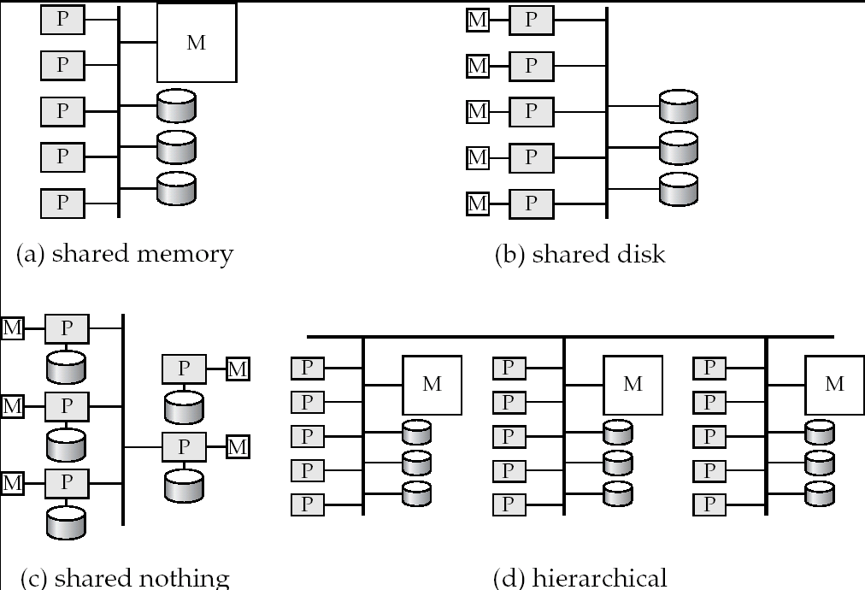
Parallel Architectures
Shared-nothing vs. shared-memory vs. shared-disk

Slide 46
Parallel Architectures

Slide 47
Parallel Architectures
Shared Memory
Shared Disk
Shared Nothing
Communication between processors
Extremely fast
Disk interconnect is very fast
Over a LAN, so slowest
Scalability ?
Not beyond 32 or 64 or so (memory bus is the bottleneck)
Not very scalable (disk interconnect is the bottleneck)
Very very scalable
Notes
Cache-coherency an issue
Transactions complicated; natural fault-tolerance.
Distributed transactions are complicated (deadlock detection etc);
Main use
Low degrees of parallelism
Not used very often
Everywhere

Slide 48
Parallel Systems
A coarse-grain parallel machine → a small number of powerful processors
A massively parallel or fine grain parallel machine → thousands of smaller processors.
We see a variety of mixes of these today, especially with the rise of multi-core machines
Two main performance measures:
throughput --- the number of tasks that can be completed in a given time interval
response time --- the amount of time it takes to complete a single task from the time it is submitted

Slide 49
Speed-Up and Scale-Up
Speedup: a fixed-sized problem executing on a small system is given to a system which is N-times larger.
Measured by:
speedup = small system elapsed time
large system elapsed time
Speedup is linear if equation equals N.
Scaleup: increase the size of both the problem and the system
N-times larger system used to perform N-times larger job
Measured by:
scaleup = small system small problem elapsed time
big system big problem elapsed time
Scale up is linear if equation equals 1.

Slide 50
Factors Limiting Speedup and Scaleup
Sequential computation: Some parts may not be parallalelizable
Amdahl’s Law: If “p” is the fraction of the task that can be parallelized, then the best speedup you can get is:
If ”p” is 0.9, the best speedup is 10
Startup costs: Cost of starting up multiple processes may dominate computation time, if the degree of parallelism is high.
Interference: Processes accessing shared resources (e.g., system bus, disks, or locks) compete with each other, thus spending time waiting on other processes, rather than performing useful work.
Skew: Increasing the degree of parallelism increases the variance in service times of parallely executing tasks. Overall execution time determined by slowest of parallely executing tasks.

Slide 51
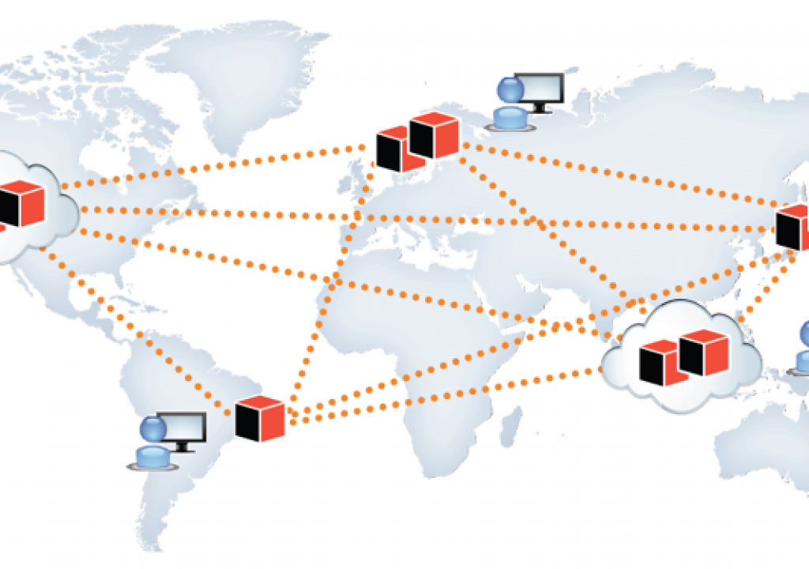
What about “Distributed” Systems?
Over a wide area network
Typically not done for performance reasons
For that, use a parallel system
Done because of necessity
Imagine a large corporation with offices all over the world
Or users distributed across the globe
Also, for redundancy and for disaster recovery reasons

Slide 52
Parallel or Distributed Systems
Key Questions from Data Management Perspective:
How to partition (or “shard”) data across a collection of storage devices/machines
How to execute an “operation” across a group of computers
In different configurations (shared-memory vs shared-disk vs shared-nothing vs NUMA)
Trade-offs and bottlenecks can be vastly different
How to execute an “update” across a group of computers
Need to ensure consistency
How to deal with “failures”

Slide 53
Data Partitioning
Partition a relation or a dataset across machines
Typically through “hashing”
Advantages:
In-memory computation: data fits in memory across machines
Parallelism: simple read/write queries can be distributed across machines
Disadvantages:
Complex queries: require combining data across all partitions, especially “joins” are tricky
R1, S1
Machine 1
Machine 1 can directly read R1, S1
If it wants R2, Machine 2 must read it and send it to Machine 1
Partitions of R (Not different relations)
R2, S2
Machine 2
R3, S3
Machine 3

Slide 54
Data Replication
A data item (file, relation, relation fragment, object, tuple) is replicated if it is stored redundantly in two or more sites
Advantages:
Availability: failures can be handled through replicas
Parallelism: queries can be run on any replica
Reduced data transfer: queries can go to the “closest” replica
Disadvantages:
Increased cost of updates: both computation as well as latency
Increased complexity of concurrency control: need to update all copies of a data item/tuple
R
Machine 1
Read queries can go to any machine
Write queries must go to “all” machines (if we want consistency)
e.g., what if Application 1 writes to Machine 1, and Application 2 sends its write to Machine 3
-- May result in an inconsistent state
R
Machine 2
R
Machine 3

Slide 55
Data Sharding + Replication
Many data management systems today combine both
Partition a dataset/file/relation into smaller pieces and distributed it across machines
Replicate each of the pieces multiple times
This may be done:
In a data center with very fast networks, or
In a wide-area setting with slower networks and higher latencies
So need to worry about:
Efficient execution of complex queries
Consistency for updates
Recovery from failures

Slide 56
Failures
Need to consider:
Disk failures: one of the disks (hard drives or SSDs) fails
Not uncommon with 10’s of thousands of disks
Network failures: machines may not be able to talk to each other
Machine failure: a machine crashes during the execution of a query or a transaction
Required guarantees:
Shouldn’t lose any data if a disk fails
Consistency (when making updates) shouldn’t be affected if one of the involved machines fails
Or if machines are not able to talk to each other
Shouldn’t have to restart a complex analytics task entirely if one of the involved machines fails

Slide 57
CMSC424: Database Design Module: NoSQL; Big Data Systems
Parallelizing Operations
Instructor: Amol Deshpande
amol@umd.edu

Slide 58
Parallelizing Operations
Book Chapters
18.5, 18.6
Key topics:
Parallelizing a Sort Operation
Parallelizing a Join Operation
Parallelizing a Group By Operation

Slide 59
Setup
Assume Shared-Nothing Model
Relations are already partitioned across a set of machines (will talk about how next video)
How to execute different operations?
R1, S1
Processor 1
Processor 1 can directly read R1, S1
If it wants R2, Processor 2 must read it and send it to Processor 1
Partitions of R (Not different relations)
R2, S2
Processor 2
R3, S3
Processor w

Slide 60
Parallel Sort
Each processor sorts a portion of the data (e.g., the data on their local disk)
If the data is small enough, all the processors can send it to a single machine to do a “merge”
If the data is large, then ”merge” itself done in parallel through range partitioning
Each processor in the merge phase gets assigned a range of the data
All other processors send the appropriate data based on that range partitioning
In either phase, the processors work by themselves (“data parallelism”) but data must be “shuffled” in between
Other approaches exist, but basically same steps

Slide 61
Parallel Sort
Partitions of R (Not different relations)
Can be same machines or different
R1
Sort R1 Locally
tuples with R.a < 100
Sort received tuples
100 <= R.a < 200
R2
Sort R2 Locally
Sort received tuples
200 <= R.a < 500
Sort R3 Locally
500 <= R.a
Sort received tuples
R3
Sort R4 Locally
Sort received tuples
R4
Shuffle – typically expensive

Slide 62
Parallel Sort
R1
(a = 10, …)
(a = 100, …)
(a = 300, …)
tuples with R.a < 100
(a = 10, …)
(a = 15, …)
(a = 85, …)
100 <= R.a < 200
R2
(a = 15, …)
(a = 85, …)
(a = 300, …)
(a = 100, …)
(a = 105, …)
(a = 150, …)
200 <= R.a < 500
(a = 105, …)
(a = 501, …)
(a = 601, …)
500 <= R.a
(a = 300, …)
(a = 300, …)
R3
(a = 150, …)
(a = 700, …)
(a = 800, …)
(a = 501, …)
(a = 601, …)
(a = 700, …)
(a = 800, …)
R4

Slide 63
Parallel Join
Hash-based approach
Very similar to how partitioning hash join works (i.e., the variant we saw for the case when the relations don’t fit in memory)
Most common for equi-joins where hashing can be used
Easier to guarantee balanced work
Sort-based approach
Similar to the parallel sort approach
Both relations sorted using the same key
Same processor used for merging in the second phase for both relations

Slide 64
Hash-based Parallel Join
R1, S1
Read R1 and Partition
Read S1 and Partition
R1 and S1 tuples with h(a) = 1
Join the R and S
tuples with h(a) = 1
h(a) = 2
R2, S2
Read R2 and Partition
Read S2 and Partition
Join the R and S
tuples with h(a) = 2
h(a) = 3
Read R3 and Partition
Read S3 and Partition
h(a) = 4
Join the R and S
tuples with h(a) = 3
R3, S3
Read R4 and Partition
Read S4 and Partition
Join the R and S
tuples with h(a) = 4
R4, S4
Shuffle – typically expensive

Slide 65
Hash-based Parallel Join
R1, S1
R1: (1, r1), (3, r2)
S1: (2, s1), (3, s2)
R1 and S1 tuples with h(a) = 1
(1, r1)
(1, s4), (1, s6)
h(a) = 2
R2, S2
R2: (4, r3), (3, r4)
S2: (2, s3), (1, s4)
(2, r6)
(2, s1), (2, s3), (2, s5), (2, s7)
h(a) = 3
R3: (3, r5), (2, r6)
S3: (2, s5), (1, s6)
h(a) = 4
(3, r2), (3, r4), (3, r8)
(3, s2)
R3, S3
R4: (4, r7), (3, r8)
S4: (2, s7), (3, s8)
(4, r3), (r, r7)
()
R4, S4
Shuffle – typically expensive

Slide 66
Fragment-and-Replicate Join
Partitioning not possible for some join conditions
E.g., non-equijoin conditions, such as r.A > s.B.
For joins were partitioning is not applicable, parallelization can be accomplished by fragment and replicate technique
Special case – asymmetric fragment-and-replicate:
One of the relations, say r, is partitioned; any partitioning technique can be used.
The other relation, s, is replicated across all the processors.
Processor P_{i} then locally computes the join of r_{i} with all of s using any join technique.

Slide 67
Asymmetric Fragment and Replicate
R1, S1
Read S1 and send
it around
All S1 tuples (no need to send if same machine)
Join R1 with all of S
All S1 tuples
R2, S2
Read S2 and send
it around
Join R2 with all of S
All S1 tuples
Read S3 and send
it around
All S1 tuples
Join R3 with all of S
R3, S3
Read S4 and send
it around
Join R4 with all of S
R4, S4

Slide 68
Grouping/Aggregation
Very common operation, especially in Map-Reduce applications
E.g., grouping by “hostnames” or “words” (as in project 5) or “labels” (in ML context), etc.
The idea of distributing data, doing some computations, and collecting results is quite powerful
Even ”joins” can be seen as a “group by” operation (you can group the tuples of the two relations on the join attribute, and then compute join)
Need to differentiate between “groupby” and “aggregate” (”reduce”)
Groupby: For every value of ”group by attribute” (i.e., “key”), collect all tuples/records with that key on a single machine
Aggregate/Reduce: Perform some computation on them, typically reducing the size of the data
Spark has more granular operations than SQL
Challenges:
Number of keys might be very large
Should try to do as much pre-aggregation as possible

Slide 69
Scenario 1: Small # of Groups + Reduce
Partitions of R (Not different relations)
(a, 5, ..)
(b, 3, ..)
(a, 4, ..)
(a, 9, ..)
(b, 3, ..)
R1
Group tuples of R1;
Compute
partial aggregates
Combine partial
aggregates
Partial aggregates
R2
Group tuples of R2;
Compute
partial aggregates
R3
Group tuples of R3;
Compute
partial aggregates
Similarly to how we have seen, ”average” would require sending ”sum” an “count”, etc
Amount of data transferred low
Requires a proper aggregate/reduce, and small number of groups
R4
Group tuples of R4;
Compute
partial aggregates

Slide 70
Scenario 2: Large # of Groups + Reduce
Use hashing to redistribute data
(a, 5, ..)
(b, 3, ..)
(a, 4, ..)
R1
Group tuples of R1;
Compute
partial aggregates
(a, 9, ..)
Combine partial
aggregates
(b, 3, ..)
R2
Group tuples of R2;
Compute
partial aggregates
Combine partial
aggregates
R3
Group tuples of R3;
Compute
partial aggregates
Combine partial
aggregates
R4
Group tuples of R4;
Compute
partial aggregates
Combine partial
aggregates

Slide 71
Scenario 3: Large # of Groups + No Reduce
e.g., if we want to compute “median” or some other complex statistics – no “partial aggregation” possible
R1
Group tuples of R1;
Redistribute using
Hashing
Compute aggregates
Or reduce functions
R2
Group tuples of R2;
Redistribute using
Hashing
Compute aggregates
Or reduce functions
R3
Group tuples of R3;
Redistribute using
Hashing
Compute aggregates
Or reduce functions
R4
Group tuples of R4;
Redistribute using
Hashing
Compute aggregates
Or reduce functions

Slide 72
Other Relational Operations
Selection σ_{θ}(r)
If θ is of the form a_{i} = v, where a_{i} is an attribute and v a value.
If r is partitioned on a_{i} the selection is performed at a single processor.
If θ is of the form l <= a_{i} <= u (i.e., θ is a range selection) and the relation has been range-partitioned on a_{i}
Selection is performed at each processor whose partition overlaps with the specified range of values.
In all other cases: the selection is performed in parallel at all the processors.

Slide 73
Other Relational Operations (Cont.)
Duplicate elimination
Perform by using either of the parallel sort techniques
eliminate duplicates as soon as they are found during sorting.
Can also partition the tuples (using either range- or hash- partitioning) and perform duplicate elimination locally at each processor.
Projection
Projection without duplicate elimination can be performed as tuples are read in from disk in parallel.
If duplicate elimination is required, any of the above duplicate elimination techniques can be used.

Slide 74
CMSC424: Database Design Module: NoSQL; Big Data Systems
Apache Spark
Instructor: Amol Deshpande
amol@umd.edu
Notes:
A

Slide 75
Apache Spark
Book Chapters
10.4 (7TH EDITION) covers this topic, but Spark programming guide is a better resource
Assignments will refer to the programming guide
Key topics:
A Resilient Distributed Dataset (RDD)
Operations on RDDs

Slide 76
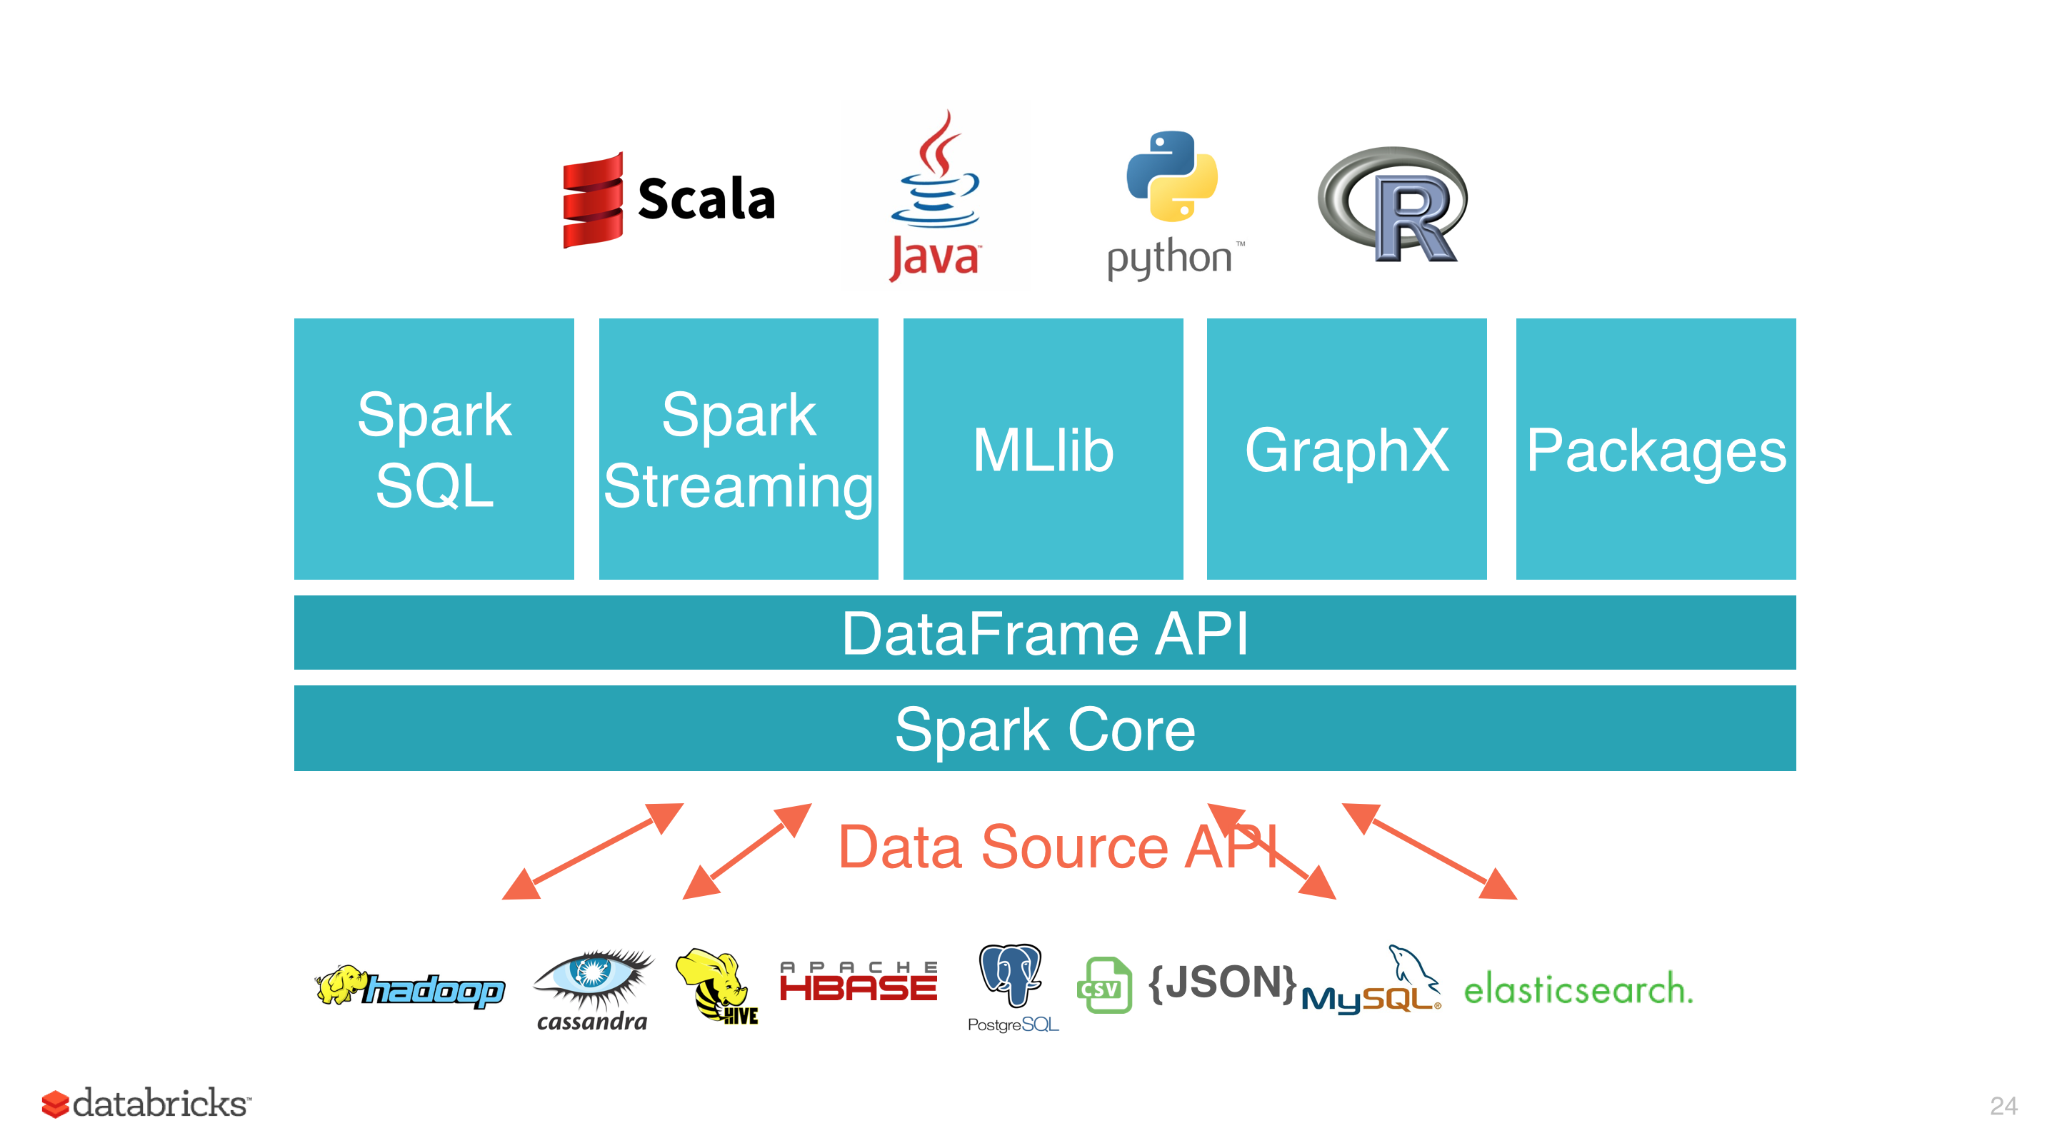
Spark
Open-source, distributed cluster computing framework
Much better performance than Hadoop MapReduce through in-memory caching and pipelining
Originally provided a low-level RDD-centric API, but today, most of the use is through the “Dataframes” (i.e., relations) API
Dataframes support relational operations like Joins, Aggregates, etc.

Slide 77
Resilient Distributed Dataset (RDD)
RDD = Collection of records stored across multiple machines in-memory
Records could be objects, or key-value pairs
Drivers
Come and go
Not fault-tolerant
In-memory partitions of RDD 1
RDD Manipulation Commands
Worker Nodes
- Always running
Results – typically at the end
In-memory partitions of RDD 2
In-memory partitions of RDD 3

Slide 78
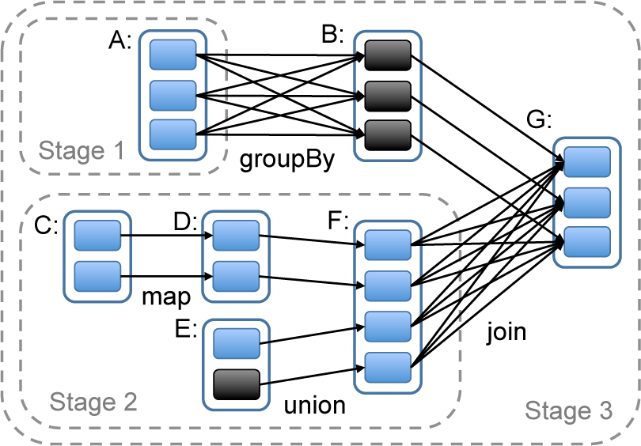
Spark
Why “Resilient”?
Can survive the failure of a worker node
Spark maintains a “lineage graph” of how each RDD partition was created
If a worker node fails, the partitions are recreated from its inputs
Only a small set of well-defined operations are permitted on the RDDs
But the operations usually take in arbitrary ”map” and “reduce” functions
Fault tolerance for the “driver” is trickier
Drivers have arbitrary logic (cf., the programs you are writing)
In some cases (e.g., Spark Streaming), you can do fault tolerance
But in general, driver failure requires a restart

Slide 79
Example Spark Program
Driver
Initialize RDD by reading the textFile and partitioning
If textFile stored on HDFS, it is already partitioned – just read each partition as a separate RDD partition
from pyspark import SparkContext
sc = SparkContext("local", "Simple App")
textFile = sc.textFile("README.md")
counts = textFile
.flatMap(lambda line: line.split(" "))
.map(lambda word: (word, 1))
.reduceByKey(lambda a, b: a + b)
print(counts.take(100))
Split each line into words, creating an RDD of words
For each word, output (word, 1), creating a new RDD
Do a group-by SUM aggregate to count the number of times each word appears
Retrieve 100 of the values in the final RDD

Slide 80
Spark
Operations often take in a ”function” as input
Using the inline “lambda” functionality
Or a more explicit function declaration
Similarly ”reduce” functions essentially tell Spark how to do pairwise aggregation
Spark will apply this to the dataset pair of values at a time
Difficult to do something like “median”
flatMap(lambda line: line.split(" "))
def split(line):
return line.split(" ")
flatMap(split)
reduceByKey(lambda a, b: a + b)

Slide 81
Spark: Map
x1, x2, … can be anything, including documents, images, text files, tuples, dicts, etc.
InputRDD: [x1, x2, …., x_n]
InputRDD: [x1, x2, …, x_n]
map(lambda x: x + 1)
def fn(x):
return x+1
map(fn)
map(fn)
outputRDD: [x1+1, x2+1, …., x_n+1]
outputRDD: [fn(x1), fn(x2), …, fn(x_n)]

Slide 82
Spark: flatMap
InputRDD: [(a1, b1), (a2, b2), ….]
InputRDD: [‘the little brown fox…’, …]
flatMap(lambda x: [x[0], x[1]])
flatMap(lambda x: x.split())
outputRDD: [a1, b1, a2, b2, …]
outputRDD: [‘the’, ‘little’, ‘brown’, …]

Slide 83
Spark: groupByKey
InputRDD: [(a1, b1), (a2, b2), (a1, b3), (a1, b4), (a2, b5)…]
InputRDD must be a collection of 2-tuples
Usually called (Key, Value) pairs
Value can be anything (e.g., dicts, tuples, bytes)
groupByKey()
outputRDD: [(a1, [b1, b3, b4, …]), (a2, [b3, b5,…]), …]

Slide 84
Spark: reduceByKey
InputRDD: [(a1, b1), (a2, b2), (a1, b3), (a1, b4), (a2, b5)…]
InputRDD must be a collection of 2-tuples
Usually called (Key, Value) pairs
def func(V1, V2):
return V3
reduceByKey(func)
All of V1, V2, and V3 be of the same type
outputRDD: [(a1, …func(func(b1, b3), b4)…),
(a2, …func(func(b2, b5), …)…),]
”func” executed in parallel in a pairwise fashion

Slide 85
Spark: join
InputRDD1: [(a1, b1), (a2, b2), (a1, b3), (a1, b4), (a2, b5)…]
InputRDD2: [(a1, c1), (a2, c2), (a1, c3), (a1, c4), (a2, c5)…]
InputRDD1 and InputRDD2 both must
be a collection of 2-tuples
inputRDD1.join(inputRDD2)
outputRDD: [ (a1, (b1, c1)),
(a1, (b1, c3)),
(a1, (b1, c4)),
….]

Slide 86
Spark: cogroup
InputRDD1: [(a1, b1), (a2, b2), (a1, b3), (a1, b4), (a2, b5)…]
InputRDD2: [(a1, c1), (a2, c2), (a1, c3), (a1, c4), (a2, c5)…]
InputRDD1 and InputRDD2 both must
be a collection of 2-tuples
inputRDD1.cogroup(inputRDD2)
outputRDD: [ (a1, ([b1, b3, b4, …], [c1, c3, c4, …]),
(a2, ([b2, b5, …], [c2, c5, …]), …
]

Slide 87
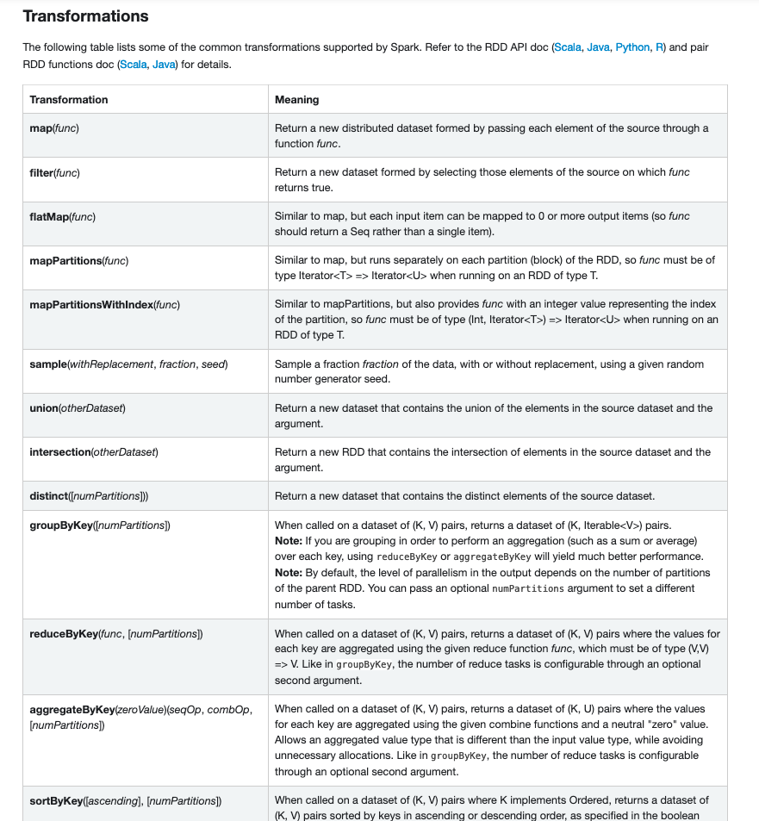
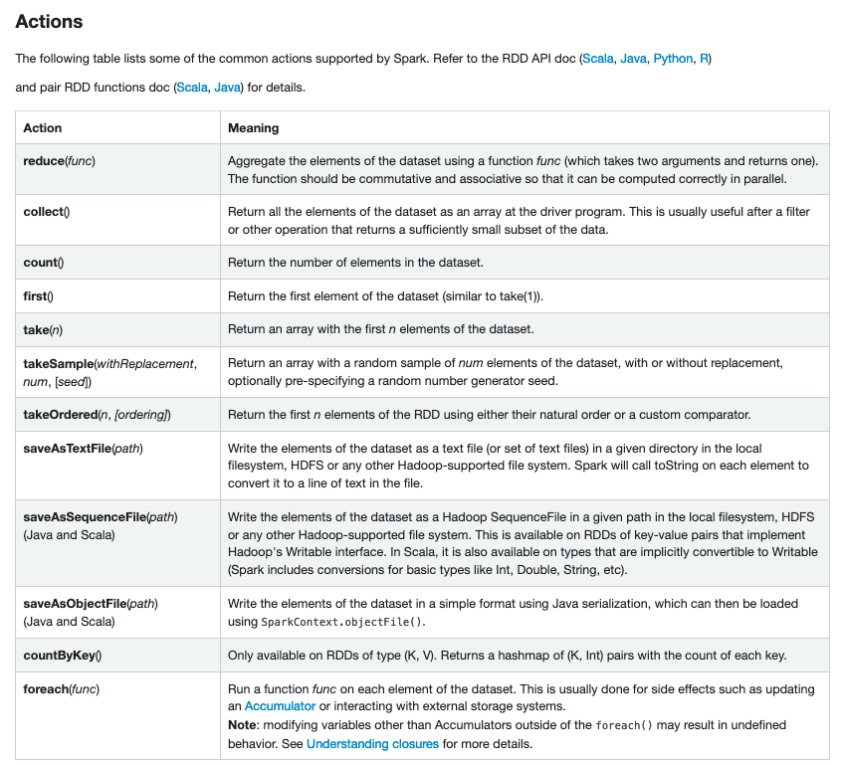
RDD Operations

Slide 88
Dataframes Example
def basic_df_example(spark):
# $example on:create_df$
# spark is an existing SparkSession
df = spark.read.json("examples/src/main/resources/people.json")
# Displays the content of the DataFrame to stdout
df.show()
# +----+-------+
# | age| name|
# +----+-------+
# |null|Michael|
# | 30| Andy|
# | 19| Justin|
# +----+-------+
# $example off:create_df$
# $example on:untyped_ops$
# spark, df are from the previous example
# Print the schema in a tree format
df.printSchema()
# root
# |-- age: long (nullable = true)
# |-- name: string (nullable = true)
# Select only the "name" column
df.select("name").show()
# +-------+
# | name|
# +-------+
# |Michael|
# | Andy|
# | Justin|
# +-------+
# Select everybody, but increment the age by 1
df.select(df['name'], df['age'] + 1).show()
# +-------+---------+
# | name|(age + 1)|
# +-------+---------+
# |Michael| null|
# | Andy| 31|
# | Justin| 20|
# +-------+---------+
# Select people older than 21
df.filter(df['age'] > 21).show()
# +---+----+
# |age|name|
# +---+----+
# | 30|Andy|
# +---+----+
# Count people by age
df.groupBy("age").count().show()
# +----+-----+
# | age|count|
# +----+-----+
# | 19| 1|
# |null| 1|
# | 30| 1|
# +----+-----+
# $example off:untyped_ops$
sqlDF = spark.sql("SELECT * FROM people")
sqlDF.show()
# +----+-------+
# | age| name|
# +----+-------+
# |null|Michael|
# | 30| Andy|
# | 19| Justin|
# +----+-------+
# $example off:run_sql$
# $example on:global_temp_view$
# Register the DataFrame as a global temporary view
df.createGlobalTempView("people")
# Global temporary view is tied to a system preserved database `global_temp`
spark.sql("SELECT * FROM global_temp.people").show()
# +----+-------+
# | age| name|
# +----+-------+
# |null|Michael|
# | 30| Andy|
# | 19| Justin|
# +----+-------+

Slide 89
Summary
Spark is a popular and widely used framework for large-scale computing
Simple programming interface
You don’t need to typically worry about the parallelization
That’s handled by Spark transparently
In practice, may need to fiddle with number of partitions etc.
Managed services supported by several vendors including Databricks (started by the authors of Spark), Cloudera, etc.
Many other concepts that we did not discuss
Shared accumulator and broadcast variables
Support for Machine Learning, Graph Analytics, Streaming, and other use cases
Alternatives include: Apache Tez, Flink, and several others

Slide 90
CMSC424: Database Design Module: NoSQL; Big Data Systems
MapReduce Overview
Instructor: Amol Deshpande
amol@umd.edu

Slide 91
Big Data; Storage Systems
Book Chapters
10.3 (7TH EDITION)
Key topics:
Why MapReduce and History
Word Count using MapReduce

Slide 92
The MapReduce Paradigm
Platform for reliable, scalable parallel computing
Abstracts issues of distributed and parallel environment from programmer
Programmer provides core logic (via map() and reduce() functions)
System takes care of parallelization of computation, coordination, etc.
Paradigm dates back many decades
But very large scale implementations running on clusters with 10^3 to 10^4 machines are more recent
Google Map Reduce, Hadoop, ..
Data storage/access typically done using distributed file systems or key-value stores

Slide 93
MapReduce Framework
Provides a fairly restricted, but still powerful abstraction for programming
Programmers write a pipeline of functions, called map or reduce
map programs
inputs: a list of “records” (record defined arbitrarily – could be images, genomes etc…)
output: for each record, produce a set of “(key, value)” pairs
reduce programs
input: a list of “(key, {values})” grouped together from the mapper
output: whatever
Both can do arbitrary computations on the input data as long as the basic structure is followed

Slide 94
MapReduce Framework
input files
mappers
intermediate
files
reducers
output
files

Slide 95
Word Count Example

Slide 96
MapReduce Framework: Word Count
input files
mappers
(a, 1)
(b, 1)
(a, 1)
(c, 1)
(d, 1)
(b, 1)
intermediate
files
reducers
output
files
a b a c d b
(a, 1)
(a, 1)
(c, 1)
(a, 1)
(a, 1)
(a, 1)
…
(a, 8)
(c, 5)
b c d a a a
(b, 1)
(d, 1)
(b, 1)
(b, 1)
(d, 1)
(b, 1)
…
(b, 6)
(d, 2)
a b a b a b
c c c c c

Slide 97
More Efficient Word Count
input files
mappers
(a, 2)
(b, 2)
(c, 1)
(d, 1)
intermediate
files
reducers
output
files
a b a c d b
(a, 2)
(a, 3)
(c, 1)
(c, 5)
(a, 8)
(c, 5)
b c d a a a
…
(b, 6)
(d, 2)
a b a b a b
c c c c c
Called “mapper-side” combiner

Slide 98
Hadoop MapReduce
Google pioneered original map-reduce implementation
For building web indexes, text analysis, PageRank, etc.
Hadoop -- widely used open source implementation in Java
Huge ecosystem built around Hadoop now, including HDFS, consistency mechanisms, connectors to different systems (e.g., key-value stores, databases), etc.
Apache Spark a newer implementation of Map-Reduce
More user-friendly syntax
Significantly faster because of in-memory processing
SQL-like in many ways (“DataFrames”)

Slide 99
CMSC424: Database Design Module: NoSQL; Big Data Systems
MongoDB
Instructor: Amol Deshpande
amol@umd.edu

Slide 100

MongoDB: History 1
A prototypical NoSQL database
Short for humongous
First version in 2009!
Still very popular
IPO in 2017
Now worth >7B in market capital (as of 2020)
Slides adapted from CS186 Slides by:
Alvin Cheung
Aditya Parameswaran

Slide 101
MongoDB: History 2
Internet & social media boom led to a demand for
Rapid data model evolution: "a move fast and break things" mentality to system dev
E.g., adding a new attrib to a Facebook profile
Contrary to DBMS wisdom of declaring schema upfront and changing rarely (costly!)
Rapid txn support, even at the cost of losing some updates or non-atomicity
Contrary to DBMS wisdom of ACID, esp. with distribution/2PC (costly!)
Early version centered around storing and querying json documents quickly
Made several tradeoffs for speed
No joins ➔ now support left outer joins
Limited query opt ➔ still limited, but many improvements
No txn support apart from atomic writes to json docs ➔ limited support for multi-doc txns
No checks/schema validation ➔ now support json schema validation (rarely used!)

Slide 102
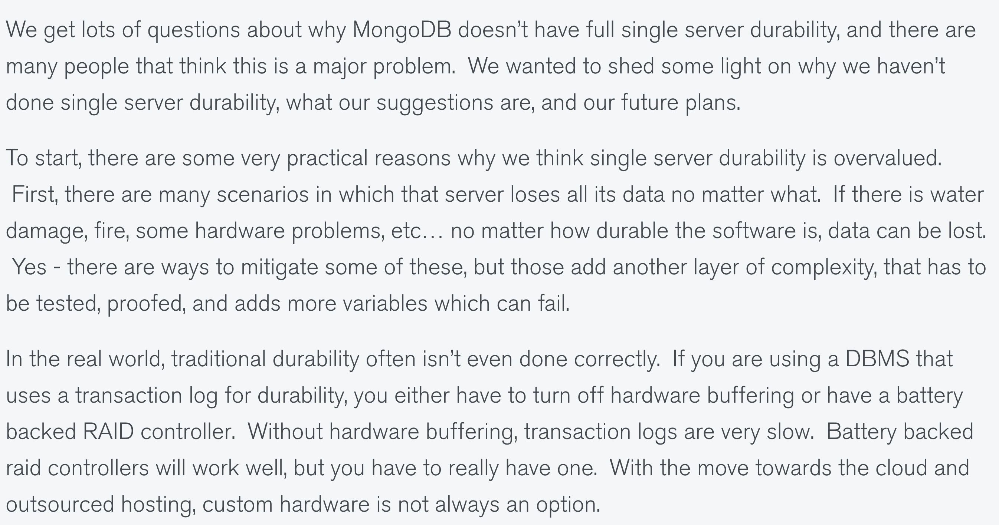
MongoDB: History 3
https://www.mongodb.com/blog/post/what-about-durability
Most egregious: no durability or write ahead logging!
Sure enough, this was fixed later (four years after the first version!)
Excuse 1:
Durability is overrated
Excuse 2: It’s hard to implement

Slide 103
MongoDB: History 4
Bottomline:
MongoDB has now evolved into a mature "DBMS" with some different design decisions, and relearning many of the canonical DBMS lessons
We’ll focus on two primary design decisions:
The data model
The query language
Will discuss these two to start with, then some of the architectural issues

Slide 104
MongoDB Data Model
Document = {…, field: value, …}
Where value can be:
Atomic
A document
An array of atomic values
An array of documents
{ qty : 1, status : "D", size : {h : 14, w : 21}, tags : ["a", "b"] },
Can also mix and match, e.g., array of atomics and documents, or array of arrays
[Same as the JSON data model]
Internally stored as BSON = Binary JSON
Client libraries can directly operate on this natively
MongoDB | DBMS
Database | Database
Collection | Relation
Document | Row/Record
Field | Column

Slide 105
MongoDB Data Model 2
MongoDB | DBMS
Database | Database
Collection | Relation
Document | Row/Record
Field | Column
Document = {…, field: value, …}
Can use JSON schema validation
Some integrity checks, field typing and ensuring the presence of certain fields
Rarely used, and we’ll skip for our discussion
Special field in each document: _id
Primary key
Will also be indexed by default
If it is not present during ingest, it will be added
Will be first attribute of each doc.
This field requires special treatment during projections as we will see later

Slide 106
MongoDB Query Language (MQL)
Input = collections, output = collections
Very similar to Spark
Three main types of queries in the query language
Retrieval: Restricted SELECT-WHERE-ORDER BY-LIMIT type queries
Aggregation: A bit of a misnomer; a general pipeline of operators
Can capture Retrieval as a special case
But worth understanding Retrieval queries first…
Updates
All queries are invoked as
db.collection.operation1(…).operation2(…)…
collection: name of collection
Unlike SQL which lists many tables in a FROM clause, MQL is centered around manipulating a single collection (like Spark)
Syntax somewhat different when called from within Python3 (using pymongo)

Slide 107
Some MQL Principles : Dot (.) Notation
"." is used to drill deeper into nested docs/arrays
Recall that a value could be atomic, a nested document, an array of atomics, or an array of nested documents
Examples:
"instock.qty" ➔ qty field within the instock field
"instock.1" ➔ second element within the instock array
Element could be an atomic value or a nested document
"instock.1.qty" ➔ qty field within the second document within the instock array
Note: such dot expressions need to be in quotes

Slide 108
Some MQL Principles : Dollar ($) Notation
$ indicates that the string is a special keyword
E.g., $gt, $lte, $add, $elemMatch, …
Used as the "field" part of a "field : value" expression
So if it is a binary operator, it is usually done as:
{LOperand : { $keyword : ROperand}}
e.g., {qty : {$gt : 30}}
Alternative: arrays
{$keyword : [argument list]}
e.g., {$add : [ 1, 2]}
Exception: $fieldName, used to refer to a previously defined field on the value side
Purpose: disambiguation
Only relevant for aggregation pipelines
Let’s not worry about this for now.

Slide 109
Retrieval Queries Template
db.collection.find(<predicate>, optional <projection>)
returns documents that match <predicate>
keep fields as specified in <projection>
both <predicate> and <projection> expressed as documents
in fact, most things are documents!
db.inventory.find( { } )
returns all documents
Syntax somewhat different when called from within Python3 (using pymongo)

Slide 110
Retrieval Queries: Basic Queries
db.collection.find(<predicate>, optional <projection>)
find( { status : "D"} )
all documents with status D ➔ paper, planner
find ( { qty : {$gte : 50} } )
all documents with qty >= 50 ➔ notebook, paper, planner
find ( { status : "D", qty : {$gte : 50} } )
all documents that satisfy both ➔ paper, planner
find( { $or: [ { status : "D" }, { qty : { $lt : 30 } } ] } )
all documents that satisfy either ➔ journal, paper, planner
Syntax somewhat different when called from within Python3 (using pymongo)

Slide 111
Retrieval Queries: Nested Documents
db.collection.find(<predicate>, optional <projection>)
find( { size: { h: 14, w: 21, uom: "cm" } } )
exact match of nested document, including ordering of fields! ➔ journal
find ( { "size.uom" : "cm", "size.h" : {$gt : 14 } )
querying a nested field ➔ planner
Note: when using . notation for sub-fields, expression must be in quotes
Also note: binary operator handled via a nested document
Syntax somewhat different when called from within Python3 (using pymongo)

Slide 112
Retrieval Queries: Arrays
Slightly different example dataset for Arrays and Arrays of Document Examples
db.collection.find(<predicate>, optional <projection>)
find( { tags: ["red", "blank"] } )
Exact match of array ➔ notebook
find( { tags: "red" } )
If one of the elements matches red ➔ journal, notebook, paper, planner
find( { tags: "red", tags: "plain" } )
If one matches red, one matches plain ➔ paper
find( { dim: { $gt: 15, $lt: 20 } } )
If one element is >15 and another is <20 ➔ journal, notebook, paper, postcard
find( { dim: {$elemMatch: { $gt: 15, $lt: 20 } } } )
If a single element is >15 and <20 ➔ postcard
find( { "dim.1": { $gt: 25 } } )
If second item > 25 ➔ planner
Notice again that we use quotes to when using . notation
Syntax somewhat different when called from within Python3 (using pymongo)
Notes:
db.inventory.insertMany( [
{ item: "journal", instock: [ { loc: "A", qty: 5 }, { loc: "C", qty: 15 } ], tags: ["blank", "red"], dim: [ 14, 21 ] },
{ item: "notebook", instock: [ { loc: "C", qty: 5 } ], tags: ["red", "blank"] , dim: [ 14, 21 ]},
{ item: "paper", instock: [ { loc: "A", qty: 60 }, { loc: "B", qty: 15 } ], tags: ["red", "blank", "plain"] , dim: [ 14, 21 ]},
{ item: "planner", instock: [ { loc: "A", qty: 40 }, { loc: "B", qty: 5 } ], tags: ["blank", "red"], dim: [ 22.85, 30 ] },
{ item: "postcard", instock: [ {loc: "B", qty: 15 }, { loc: "C", qty: 35 } ], tags: ["blue"] , dim: [ 10, 15.25 ]} ]);

Slide 113
Retrieval Queries: Arrays of Documents
db.collection.find(<predicate>, optional <projection>)
find( { instock: { loc: "A", qty: 5 } } )
Exact match of document [like nested doc/atomic array case] ➔ journal
find( { "instock.qty": { $gte : 20 } } )
One nested doc has >= 20 ➔ paper, planner, postcard
find( { "instock.0.qty": { $gte : 20 } } )
First nested doc has >= 20 ➔ paper, planner
find( { "instock": { $elemMatch: { qty: { $gt: 10, $lte: 20 } } } } )
One doc has 20 >= qty >10➔ paper, journal, postcard
find( { "instock.qty": { $gt: 10, $lte: 20 } } )
One doc has 20 >= qty, another has qty>10 ➔ paper, journal, postcard, planner
Syntax somewhat different when called from within Python3 (using pymongo)
Notes:
db.inventory.insertMany( [
{ item: "journal", instock: [ { loc: "A", qty: 5 }, { loc: "C", qty: 15 } ], tags: ["blank", "red"], dim: [ 14, 21 ] },
{ item: "notebook", instock: [ { loc: "C", qty: 5 } ], tags: ["red", "blank"] , dim: [ 14, 21 ]},
{ item: "paper", instock: [ { loc: "A", qty: 60 }, { loc: "B", qty: 15 } ], tags: ["red", "blank", "plain"] , dim: [ 14, 21 ]},
{ item: "planner", instock: [ { loc: "A", qty: 40 }, { loc: "B", qty: 5 } ], tags: ["blank", "red"], dim: [ 22.85, 30 ] },
{ item: "postcard", instock: [ {loc: "B", qty: 15 }, { loc: "C", qty: 35 } ], tags: ["blue"] , dim: [ 10, 15.25 ]} ]);

Slide 114
Retrieval Queries Template: Projection
db.collection.find(<predicate>, optional <projection>)
Use 1s to indicate fields that you want
Exception: _id is always present unless explicitly excluded
OR Use 0s to indicate fields you don’t want
Mixing 0s and 1s is not allowed for non _id fields
find( { }, {item: 1})
{ "_id" : ObjectId("5fb59ab9f50b800678c0e196"), "item" : "journal" }
{ "_id" : ObjectId("5fb59ab9f50b800678c0e197"), "item" : "notebook" }
{ "_id" : ObjectId("5fb59ab9f50b800678c0e198"), "item" : "paper" }
{ "_id" : ObjectId("5fb59ab9f50b800678c0e199"), "item" : "planner" }
{ "_id" : ObjectId("5fb59ab9f50b800678c0e19a"), "item" : "postcard" }
find( { }, {item: 1, _id : 0})
{ "item" : "journal" }
{ "item" : "notebook" }
{ "item" : "paper" }
{ "item" : "planner" }
{ "item" : "postcard" }
find({},{item : 1, tags: 0, _id : 0})
Error: error: {
"ok" : 0,
"errmsg" : "Cannot do exclusion on field tags in inclusion projection",
"code" : 31254,
"codeName" : "Location31254" }
find({},{item : 1, "instock.loc": 1, _id : 0})
{ "item" : "journal", "instock" : [ { "loc" : "A" }, { "loc" : "C" } ] }
{ "item" : "notebook", "instock" : [ { "loc" : "C" } ] }
{ "item" : "paper", "instock" : [ { "loc" : "A" }, { "loc" : "B" } ] }
{ "item" : "planner", "instock" : [ { "loc" : "A" }, { "loc" : "B" } ] }
{ "item" : "postcard", "instock" : [ { "loc" : "B" }, { "loc" : "C" } ] }
Syntax somewhat different when called from within Python3 (using pymongo)

Slide 115
Retrieval Queries : Addendum
Two additional operations that are useful for retrieval:
Limit (k) like LIMIT in SQL
e.g., db.inventory.find( { } ).limit(1)
Sort ({ }) like ORDER BY in SQL
List of fields, -1 indicates decreasing 1 indicates ascending
e.g., db.inventory.find( { }, {_id : 0, instock : 0} ).sort( { "dim.0": -1, item: 1 } )
{ "item" : "planner", "tags" : [ "blank", "red" ], "dim" : [ 22.85, 30 ] }
{ "item" : "journal", "tags" : [ "blank", "red" ], "dim" : [ 14, 21 ] }
{ "item" : "notebook", "tags" : [ "red", "blank" ], "dim" : [ 14, 21 ] }
{ "item" : "paper", "tags" : [ "red", "blank", "plain" ], "dim" : [ 14, 21 ] }
{ "item" : "postcard", "tags" : [ "blue" ], "dim" : [ 10, 15.25 ] }
Syntax somewhat different when called from within Python3 (using pymongo)

Slide 116
Retrieval Queries: Summary
find() = SELECT <projection>
FROM Collection
WHERE <predicate>
limit() = LIMIT
sort() = ORDER BY
db.inventory.find(
{ tags : red },
{_id : 0, instock : 0} )
.sort ( { "dim.0": -1, item: 1 } )
.limit (2)
FROM
WHERE
SELECT
ORDER BY
LIMIT
Syntax somewhat different when called from within Python3 (using pymongo)

Slide 117
What did we not cover?
The use of regexes for matching
$all : all entries in an array satisfy a condition
$in : checking if a value is present in an array of atomic values
The presence or absence of fields
Can use special “null” values
{field : null} checks if a field is null or missing
$exists : checking the presence/absence of a field
Syntax somewhat different when called from within Python3 (using pymongo)

Slide 118
MongoDB Query Language (MQL)
Input = collections, output = collections
Very similar to Spark
Three main types of queries in the query language
Retrieval: Restricted SELECT-WHERE-ORDER BY-LIMIT type queries
Aggregation: A bit of a misnomer; a general pipeline of operators
Can capture Retrieval as a special case
But worth understanding Retrieval queries first…
Updates
All queries are invoked as
db.collection.operation1(…).operation2(…)…
collection: name of collection
Unlike SQL which lists many tables in a FROM clause, MQL is centered around manipulating a single collection (like Spark)
Syntax somewhat different when called from within Python3 (using pymongo)

Slide 119
Aggregation Pipelines
Composed of a linear pipeline of stages
Each stage corresponds to one of:
match // first arg of find ( )
project // second arg of find ( ) but more expressiveness
sort/limit // same as retrieval
group
unwind
lookup
… lots more!!
Each stage manipulates the existing collection in some way
match
lookup
group
match
project
Syntax:
db.collection.aggregate ( [
{ $stage1Op: { } },
{ $stage2Op: { } },
…
{ $stageNOp: { } }
] )

Slide 120
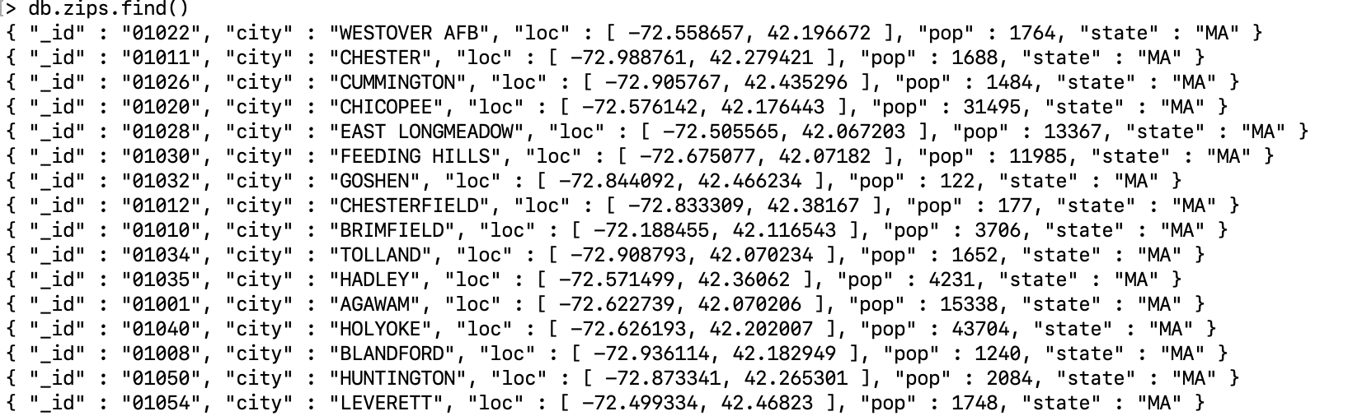
Next Set of Examples
One document per zipcode: 29353 zipcodes
Syntax somewhat different when called from within Python3 (using pymongo)
Notes:
Dataset: https://docs.mongodb.com/manual/tutorial/aggregation-zip-code-data-set/

Slide 121
Grouping (with match/sort) Simple Example
Find states with population > 15M, sort by decending order
db.zips.aggregate( [
{ $group: { _id: "$state", totalPop: { $sum: "$pop" } } },
{ $match: { totalPop: { $gte: 15000000 } } },
{ $sort : { totalPop : -1 } }
] )
{ "_id" : "CA", "totalPop" : 29754890 }
{ "_id" : "NY", "totalPop" : 17990402 }
{ "_id" : "TX", "totalPop" : 16984601 }
…
Q: what would the SQL query for this be?
GROUP BY
AGGS.
group
match
sort
match after group = HAVING
SELECT state AS id, SUM(pop) AS totalPop
FROM zips
GROUP BY state
HAVING totalPop >= 15000000
ORDER BY totalPop DESCENDING
Syntax somewhat different when called from within Python3 (using pymongo)

Slide 122
Grouping Syntax
$group : {
_id: <expression>, // Group By Expression
<field1>: { <aggfunc1> : <expression1> },
... }
Returns one document per unique group, indexed by _id
Agg.func. can be standard ops like $sum, $avg, $max
Also MQL specific ones:
$first : return the first expression value per group
makes sense only if docs are in a specific order [usually done after sort]
$push : create an array of expression values per group
didn’t make sense in a relational context because values are atomic
$addToSet : like $push, but eliminates duplicates

Slide 123
Multiple Attrib. Grouping Example
Group by 2 attribs, giving nested id
group
group
aggregate( [
{ $group: { _id: { state: "$state", city: "$city" }, pop: { $sum: "$pop" } } },
{ $group: { _id: "$_id.state", avgCityPop: { $avg: "$pop" } } }
] )
Q: Guesses on what this might be doing?
A: Find average city population per state
{ "_id" : "GA", "avgCityPop" : 11547.62210338681 }
{ "_id" : "WI", "avgCityPop" : 7323.00748502994 }
{ "_id" : "FL", "avgCityPop" : 27400.958963282937 }
{ "_id" : "OR", "avgCityPop" : 8262.561046511628 }
{ "_id" : "SD", "avgCityPop" : 1839.6746031746031 }
{ "_id" : "NM", "avgCityPop" : 5872.360465116279 }
{ "_id" : "MD", "avgCityPop" : 12615.775725593667 }
…
Group by previously def. id.state
Notice use of $ to refer to previously defined fields
Syntax somewhat different when called from within Python3 (using pymongo)

Slide 124
Multiple Agg. Example
Find, for every state, the biggest city and its population
aggregate( [
{ $group: { _id: { state: "$state", city: "$city" }, pop: { $sum: "$pop" } } },
{ $sort: { pop: -1 } },
{ $group: { _id : "$_id.state", bigCity: { $first: "$_id.city" }, bigPop: { $first: "$pop" } } },
{ $sort : {bigPop : -1} }
] )
Approach:
Group by pair of city and state, and compute population per city
Order by population descending
Group by state, and find first city and population per group (i.e., the highest population city)
Order by population descending
{ ”_id" : "IL", "bigCity" : "CHICAGO", "bigPop" : 2452177 }
{ "_id" : "NY", "bigCity" : "BROOKLYN", "bigPop" : 2300504 }
{ "_id" : "CA", "bigCity" : "LOS ANGELES", "bigPop" : 2102295 }
{ "_id" : "TX", "bigCity" : "HOUSTON", "bigPop" : 2095918 }
{ "_id" : "PA", "bigCity" : "PHILADELPHIA", "bigPop" : 1610956 }
{ "_id" : "MI", "bigCity" : "DETROIT", "bigPop" : 963243 }
…
group
sort
group
sort
Can list multiple aggregations after grouping id
Syntax somewhat different when called from within Python3 (using pymongo)

Slide 125
Multiple Agg. with Vanilla Projection Example
If we only want to keep the state and city …
aggregate( [
{ $group: { _id: { state: "$state", city: "$city" }, pop: { $sum: "$pop" } } },
{ $sort: { pop: -1 } },
{ $group: { _id : "$_id.state", bigCity: { $first: "$_id.city" }, bigPop: { $first: "$pop" } } },
{ $sort : {bigPop : -1} }
{ $project : {bigPop : 0} }
] )
{ "_id" : "IL", "bigCity" : "CHICAGO" }
{ "_id" : "NY", "bigCity" : "BROOKLYN" }
{ "_id" : "CA", "bigCity" : "LOS ANGELES" }
{ "_id" : "TX", "bigCity" : "HOUSTON" }
{ "_id" : "PA", "bigCity" : "PHILADELPHIA" }
…
group
sort
group
sort
project
Syntax somewhat different when called from within Python3 (using pymongo)

Slide 126
Multiple Agg. with Adv. Projection Example
Can construct new nested documents in output, unlike vanilla projection
If we wanted to nest the name of the city and population into a nested doc
aggregate( [
{ $group: { _id: { state: "$state", city: "$city" }, pop: { $sum: "$pop" } } },
{ $sort: { pop: -1 } },
{ $group: { _id : "$_id.state", bigCity: { $first: "$_id.city" }, bigPop: { $first: "$pop" } } },
{ $sort : {bigPop : -1} },
{ $project : { _id : 0, state : "$_id", bigCityDeets: { name: "$bigCity", pop: "$bigPop" } } }
] )
{ "state" : "IL", "bigCityDeets" : { "name" : "CHICAGO", "pop" : 2452177 } }
{ "state" : "NY", "bigCityDeets" : { "name" : "BROOKLYN", "pop" : 2300504 } }
{ "state" : "CA", "bigCityDeets" : { "name" : "LOS ANGELES", "pop" : 2102295 } }
{ "state" : "TX", "bigCityDeets" : { "name" : "HOUSTON", "pop" : 2095918 } }
{ "state" : "PA", "bigCityDeets" : { "name" : "PHILADELPHIA", "pop" : 1610956 } }
…
Syntax somewhat different when called from within Python3 (using pymongo)

Slide 127
Advanced Projection vs. Vanilla Projection
In addition to excluding/including fields like in projection during retrieval (find), projection in the aggregation pipeline allows you to:
Rename fields
Redefine new fields using complex expressions on old fields
Reorganize fields into nestings or unnestings
Reorganize fields into arrays or break down arrays
Try them at home!

Slide 128
Aggregation Pipelines
Composed of a linear pipeline of stages
Each stage corresponds to one of:
match // first arg of find ( )
project // second arg of find ( ) but more expressiveness
sort/limit // same
group
unwind
lookup
… lots more!!
Each stage manipulates the existing collection in some way
match
lookup
group
match
project
Syntax:
db.collection.aggregate ( [
{ $stage1Op: { } },
{ $stage2Op: { } },
…
{ $stageNOp: { } }
] }
Syntax somewhat different when called from within Python3 (using pymongo)

Slide 129
Unwinding Arrays
Unwind expands an array by constructing documents one per element of the array
Somewhat like flatMap in Spark
Going back to our old example with an array of tags
Notice no relational analog here: no arrays so no unwinding
[in fact, some RDBMSs do support arrays, but not in the rel. model]
aggregate( [
{ $unwind : "$tags" },
{ $project : {_id : 0, instock: 0}}
] )
{ "item" : "journal", "tags" : "blank", "dim" : [ 14, 21 ] }
{ "item" : "journal", "tags" : "red", "dim" : [ 14, 21 ] }
{ "item" : "notebook", "tags" : "red", "dim" : [ 14, 21 ] }
{ "item" : "notebook", "tags" : "blank", "dim" : [ 14, 21 ] }
{ "item" : "paper", "tags" : "red", "dim" : [ 14, 21 ] }
{ "item" : "paper", "tags" : "blank", "dim" : [ 14, 21 ] }
{ "item" : "paper", "tags" : "plain", "dim" : [ 14, 21 ] }
{ "item" : "planner", "tags" : "blank", "dim" : [ 22.85, 30 ] }
{ "item" : "planner", "tags" : "red", "dim" : [ 22.85, 30 ] }
{ "item" : "postcard", "tags" : "blue", "dim" : [ 10, 15.25 ] }
Syntax somewhat different when called from within Python3 (using pymongo)
Notes:
db.inventory.insertMany( [
{ item: "journal", instock: [ { loc: "A", qty: 5 }, { loc: "C", qty: 15 } ], tags: ["blank", "red"], dim: [ 14, 21 ] },
{ item: "notebook", instock: [ { loc: "C", qty: 5 } ], tags: ["red", "blank"] , dim: [ 14, 21 ]},
{ item: "paper", instock: [ { loc: "A", qty: 60 }, { loc: "B", qty: 15 } ], tags: ["red", "blank", "plain"] , dim: [ 14, 21 ]},
{ item: "planner", instock: [ { loc: "A", qty: 40 }, { loc: "B", qty: 5 } ], tags: ["blank", "red"], dim: [ 22.85, 30 ] },
{ item: "postcard", instock: [ {loc: "B", qty: 15 }, { loc: "C", qty: 35 } ], tags: ["blue"] , dim: [ 10, 15.25 ]} ]);

Slide 130
Unwind: A Common Template
Q: Imagine if we want to find sum of qtys across items. How would we do this?
A common recipe in MQL queries is to unwind and then group by
aggregate( [
{ $unwind : "$instock" },
{ $group : {_id : "$item", totalqty : {$sum : "$instock.qty"}}}
] )
{ "_id" : "notebook", "totalqty" : 5 }
{ "_id" : "postcard", "totalqty" : 50 }
{ "_id" : "journal", "totalqty" : 20 }
{ "_id" : "planner", "totalqty" : 45 }
{ "_id" : "paper", "totalqty" : 75 }
Syntax somewhat different when called from within Python3 (using pymongo)
Notes:
db.inventory.insertMany( [
{ item: "journal", instock: [ { loc: "A", qty: 5 }, { loc: "C", qty: 15 } ], tags: ["blank", "red"], dim: [ 14, 21 ] },
{ item: "notebook", instock: [ { loc: "C", qty: 5 } ], tags: ["red", "blank"] , dim: [ 14, 21 ]},
{ item: "paper", instock: [ { loc: "A", qty: 60 }, { loc: "B", qty: 15 } ], tags: ["red", "blank", "plain"] , dim: [ 14, 21 ]},
{ item: "planner", instock: [ { loc: "A", qty: 40 }, { loc: "B", qty: 5 } ], tags: ["blank", "red"], dim: [ 22.85, 30 ] },
{ item: "postcard", instock: [ {loc: "B", qty: 15 }, { loc: "C", qty: 35 } ], tags: ["blue"] , dim: [ 10, 15.25 ]} ]);

Slide 131
Looking Up Other Collections
{ $lookup: {
from: <collection to join>,
localField: <referencing field>,
foreignField: <referenced field>,
as: <output array field>
} }
Conceptually, for each document
find documents in other coll that join (equijoin)
local field must match foreign field
place each of them in an array
Thus, a left outer equi-join, with the join results stored in an array
Straightforward, but kinda gross. Let’s see…
Say, for each item, I want to find other items located in the same location = self-join
db.inventory.aggregate( [
{ $lookup : {from : "inventory", localField: "instock.loc", foreignField: "instock.loc", as:"otheritems"}},
{ $project : {_id : 0, tags : 0, dim : 0}}
] )
{ "item" : "journal", "instock" : [ { "loc" : "A", "qty" : 5 }, { "loc" : "C", "qty" : 15 } ], "otheritems" : [
{ "_id" : ObjectId("5fb6f9605f0594e0227d3c24"), "item" : "journal", "instock" : [ { "loc" : "A", "qty" : 5 }, { "loc" : "C", "qty" : 15 } ], "tags" : [ "blank", "red" ], "dim" : [ 14, 21 ] },
{ "_id" : ObjectId("5fb6f9605f0594e0227d3c25"), "item" : "notebook", "instock" : [ { "loc" : "C", "qty" : 5 } ], "tags" : [ "red", "blank" ], "dim" : [ 14, 21 ] },
{ "_id" : ObjectId("5fb6f9605f0594e0227d3c26"), "item" : "paper", "instock" : [ { "loc" : "A", "qty" : 60 }, { "loc" : "B", "qty" : 15 } ], "tags" : [ "red", "blank", "plain" ], "dim" : [ 14, 21 ] },
…
] }
And many other records!
Syntax somewhat different when called from within Python3 (using pymongo)

Slide 132
Lookup… after some more projection
db.inventory.aggregate( [
{ $lookup : {from:"inventory", localField:"instock.loc", foreignField:"instock.loc", as:"otheritems"}},
{$project : {_id : 0, tags :0, dim :0, "otheritems._id":0, "otheritems.tags":0, "otheritems.dim":0, "otheritems.instock.qty":0}} ] )
{ "item" : "journal", "instock" : [ { "loc" : "A", "qty" : 5 }, { "loc" : "C", "qty" : 15 } ], "otheritems" : [
{ "item" : "journal", "instock" : [ { "loc" : "A" }, { "loc" : "C" } ] },
{ "item" : "notebook", "instock" : [ { "loc" : "C" } ] },
{ "item" : "paper", "instock" : [ { "loc" : "A" }, { "loc" : "B" } ] },
{ "item" : "planner", "instock" : [ { "loc" : "A" }, { "loc" : "B" } ] },
{ "item" : "postcard", "instock" : [ { "loc" : "B" }, { "loc" : "C" } ] } ] }
{ "item" : "notebook", "instock" : [ { "loc" : "C", "qty" : 5 } ], "otheritems" : [
{ "item" : "journal", "instock" : [ { "loc" : "A" }, { "loc" : "C" } ] },
{ "item" : "notebook", "instock" : [ { "loc" : "C" } ] },
{ "item" : "postcard", "instock" : [ { "loc" : "B" }, { "loc" : "C" } ] } ] }
…
Syntax somewhat different when called from within Python3 (using pymongo)

Slide 133
Some Rules of Thumb when Writing Queries
$project is helpful if you want to construct or deconstruct nestings (in addition to removing fields or creating new ones)
$group is helpful to construct arrays (using $push or $addToSet)
$unwind is helpful for unwinding arrays
$lookup is your only hope for joins. Be prepared for a mess. Lots of $project needed

Slide 134
MongoDB Query Language (MQL)
Input = collections, output = collections
Very similar to Spark
Three main types of queries in the query language
Retrieval: Restricted SELECT-WHERE-ORDER BY-LIMIT type queries
Aggregation: A bit of a misnomer; a general pipeline of operators
Can capture Retrieval as a special case
But worth understanding Retrieval queries first…
Updates
All queries are invoked as
db.collection.operation1(…).operation2(…)…
collection: name of collection
Unlike SQL which lists many tables in a FROM clause, MQL is centered around manipulating a single collection (like Spark)
Syntax somewhat different when called from within Python3 (using pymongo)

Slide 135
Update Queries: InsertMany
[Insert/Delete/Update] [One/Many]
Many is more general, so we’ll discuss that instead
db.inventory.insertMany( [
{ item: "journal", instock: [ { loc: "A", qty: 5 }, { loc: "C", qty: 15 } ], tags: ["blank", "red"], dim: [ 14, 21 ] },
{ item: "notebook", instock: [ { loc: "C", qty: 5 } ], tags: ["red", "blank"] , dim: [ 14, 21 ]},
{ item: "paper", instock: [ { loc: "A", qty: 60 }, { loc: "B", qty: 15 } ], tags: ["red", "blank", "plain"] , dim: [ 14, 21 ]},
{ item: "planner", instock: [ { loc: "A", qty: 40 }, { loc: "B", qty: 5 } ], tags: ["blank", "red"], dim: [ 22.85, 30 ] },
{ item: "postcard", instock: [ {loc: "B", qty: 15 }, { loc: "C", qty: 35 } ], tags: ["blue"] , dim: [ 10, 15.25 ] }
] );
Several actions will be taken as part of this insert:
Will create inventory collection if absent [No schema specification/DDL needed!]
Will add the _id attrib to each document added (since it isn’t there)
_id will be the first field for each document by default

Slide 136
Update Queries: UpdateMany
Syntax: updateMany ( {<condition>}, {<change>})
db.inventory.updateMany (
{"dim.0": { $lt: 15 } },
{ $set: { "dim.0": 15, status: "InvalidWidth"} }
) // if any width <15, set it to 15 and set status to InvalidWidth.
Analogous to: UPDATE R SET <change> WHERE <condition>

Slide 137
Update Queries: UpdateMany 2
Syntax: updateMany ( {<condition>}, {<change>})
db.inventory.updateMany (
{"dim.0": { $lt: 15 } },
{ $inc: { "dim.0": 5},
$set: {status: "InvalidWidth"} } )
// if any width <15, increment by 5 and set status to InvalidWidth.
Analogous to: UPDATE R SET <change> WHERE <condition

Slide 138
MongoDB Internals
MongoDB is a distributed NoSQL database
Collections are partitioned/sharded based on a field [range-based]
Each partition stores a subset of documents
Each partition is replicated to help with failures
The replication is done asynchronously
Failures of the main partition that haven’t been propagated will be lost
Limited heuristic-based query optimization (will discuss later)
Atomic writes to documents within collections by default. Multi-document txns are discouraged (but now supported).

Slide 139
MongoDB Internals
Weird constraint: intermediate results of aggregations must not be too large (100MB)
Else will end up spilling to disk
Not clear if they perform any pipelining across aggregation operators
Optimization heuristics
Will use indexes for $match if early in the pipeline [user can explicitly declare]
$match will be merged with other $match if possible
Selection fusion
$match will be moved early in the pipeline sometimes
Selection pushdown
But: not done always (e.g., not pushed before $lookup)
No cost-based optimization as far as one can tell

Slide 140
MongoDB: Summary
Bottomline:
MongoDB has now evolved into a mature "DBMS" with some different design decisions, and relearning many of the canonical DBMS lessons
MongoDB has a flexible data model and a powerful (if confusing) query language.
Many of the internal design decisions as well as the query & data model can be understood when compared with DBMSs
DBMSs provide a "gold standard" to compare against.
In the "wild" you’ll encounter many more NoSQL systems, and you’ll need to do the same thing that we did here!

Slide 141
CMSC424: Database Design Module: NoSQL; Big Data Systems
Other Storage Systems; Wrapup
Instructor: Amol Deshpande
amol@umd.edu

Slide 142
Big Data Storage Options
Parallel or distributed databases
Suffer from the issues discussed earlier
Distributed File Systems
Also called object stores
A “data lake” is basically a collection of files in a dfs
Structured data (relational-like) stored in files (more sophisticated “csv” files)
Key-value Storage Systems
Document stores (MongoDB, etc)
Wide column stores (HBase, Cassandra)
Graph Stores (Neo4j)
And many others…

Slide 143
Distributed File Systems
A distributed file system stores data across a large collection of machines, but provides single file-system view
Highly scalable distributed file system for large data-intensive applications.
E.g., 10K nodes, 100 million files, 10 PB
Provides redundant storage of massive amounts of data on cheap and unreliable computers
Files are replicated to handle hardware failure
Detect failures and recovers from them
Examples:
Google File System (GFS)
Hadoop File System (HDFS)

Slide 144
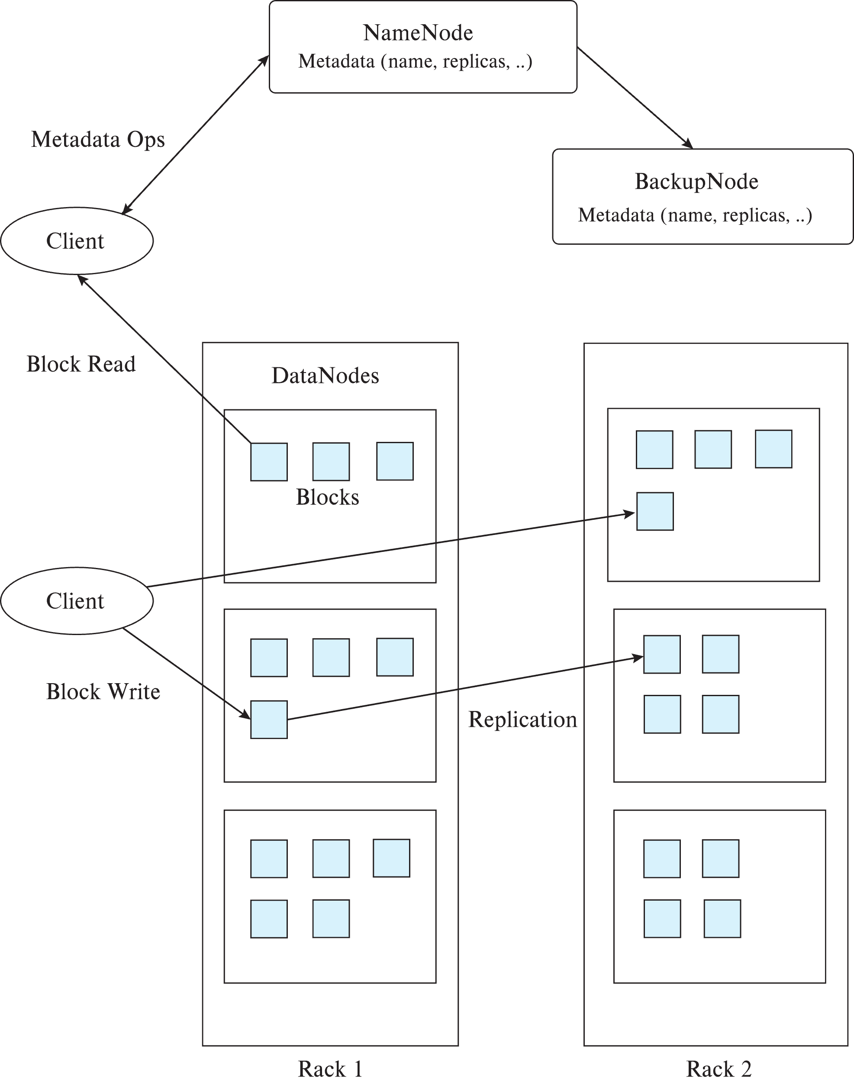
Hadoop File System Architecture
Single Namespace for entire cluster
Files are broken up into blocks
Typically 64 MB block size
Each block replicated on multiple DataNodes
Client
Finds location of blocks from NameNode
Accesses data directly from DataNode
Maps a filename to list of Block IDs
Maps each Block ID to DataNodes containing a replica of the block
Maps a Block ID to a physical location on disk

Slide 145
Key-Value Storage Systems
Unlike HDFS, focus here on storing large numbers (billions or even more) of small (KB-MB) sized records
uninterpreted bytes, with an associated key
E.g., Amazon S3, Amazon Dynamo
Wide-table (can have arbitrarily many attribute names) with associated key
Google BigTable, Apache Cassandra, Apache Hbase, Amazon DynamoDB
Allows some operations (e.g., filtering) to execute on storage node
JSON
MongoDB, CouchDB (document model)
Records partitioned across multiple machines
Queries are routed by the system to appropriate machine
Records replicated across multiple machines for fault tolerance as well as efficient querying
Need to guarantee “consistency” when data is updated
“Distributed Transactions”

Slide 146
Key-Value Storage Systems
Key-value stores support
put(key, value): used to store values with an associated key,
get(key): which retrieves the stored value associated with the specified key
delete(key) -- Remove the key and its associated value
Some support range queries on key values
Document stores support richer queries (e.g., MongoDB)
Slowly evolving towards the richness of SQL
Not full database systems (increasingly changing)
Have no/limited support for transactional updates
Applications must manage query processing on their own
Not supporting above features makes it easier to build scalable data storage systems, i.e., NoSQL systems

Slide 147
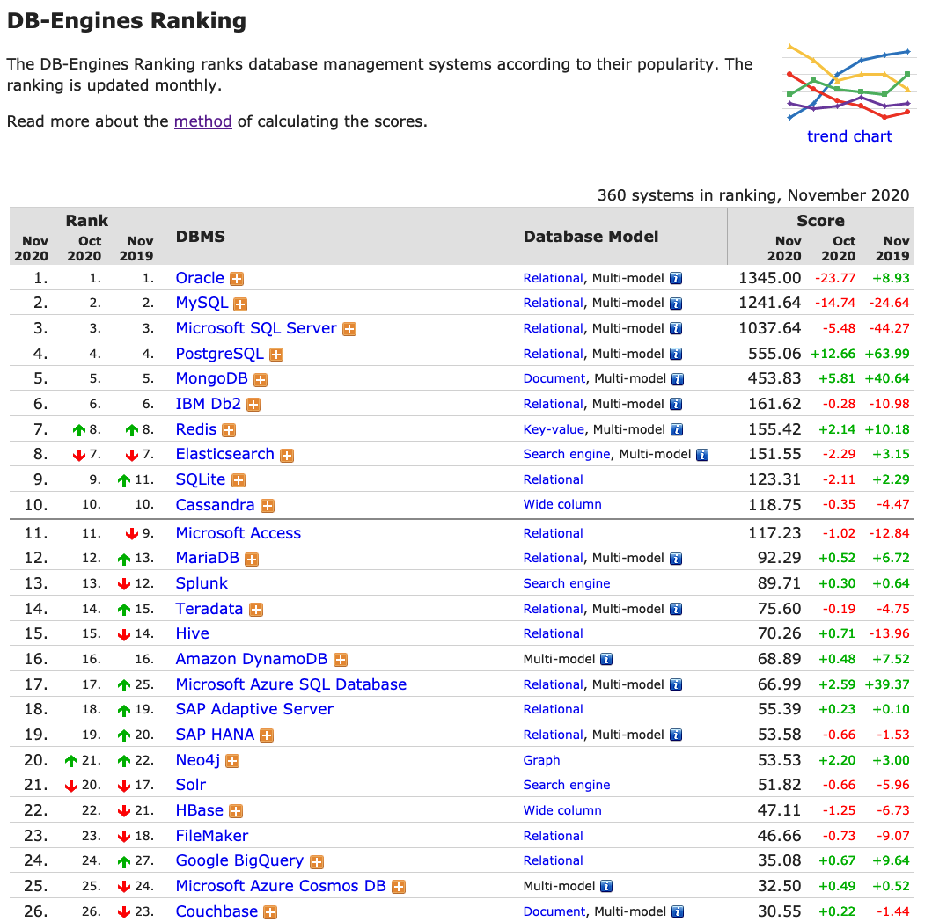
MongoDB

Slide 148
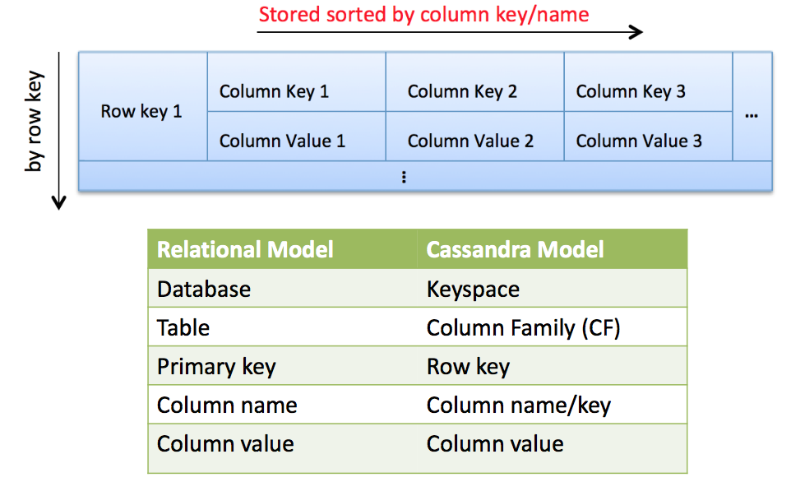
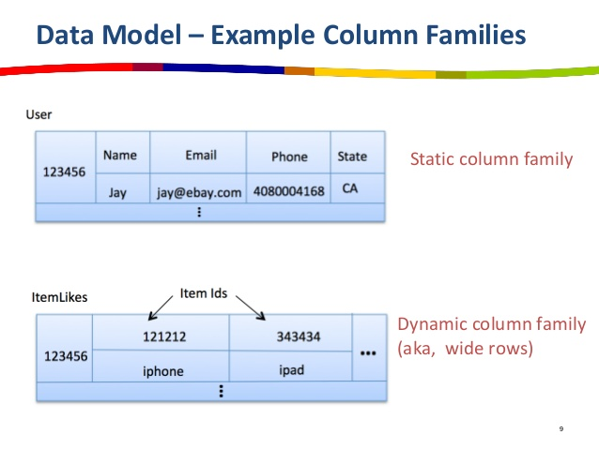
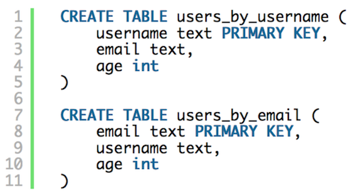
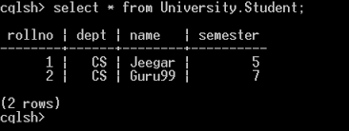
Apache Cassandra
Wide-table key value store

Slide 149
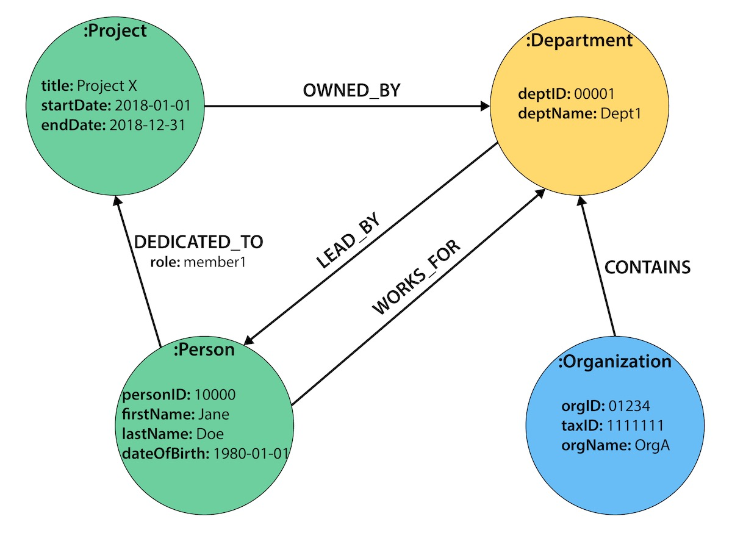
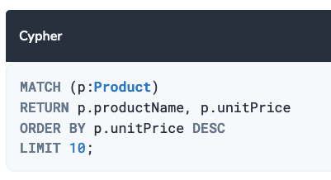
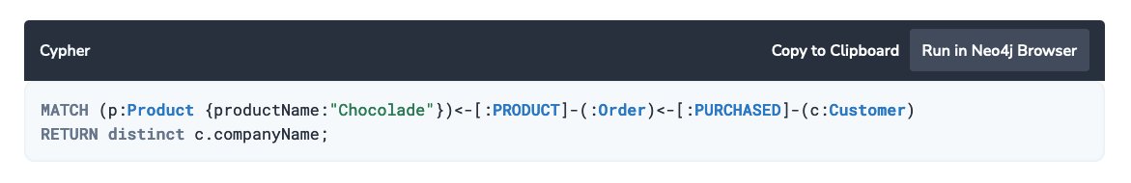
Neo4j
Graph Database using a Property Graph Model

Slide 150
Summary
Traditional databases don’t provide the right abstractions for many newer data processing/analytics tasks
Led to development of NoSQL systems and Map-Reduce (or similar) frameworks
Easier to get started
Easier to handle ad hoc and arbitrary tasks
Not as efficient
Over the last 10 years, seen increasing convergence
NoSQL stores increasingly support SQL constructs like joins and aggregations
Map-reduce frameworks also evolved to support joins and SQL more explicitly
Databases evolved to support more data types, richer functionality for ad hoc processing
Think of Map-Reduce systems as another option
Appropriate in some cases, not a good fit in other cases

